Slide 1
Lecture 12:
3.4. Modern Economic Growth
Brad DeLong
Department of Economics and Blum Center, U.C. Berkeley; and WCEG
last revised: 2020-03-02
for presentation: 2020-03-05
Original course by Melissa Dell (Harvard Econ 1342), revised by Brad DeLong
<https://github.com/braddelong/public-files/blob/master/econ-135-lecture-12.pptx>

Slide 2
Roadmap for the Next Two Weeks
12. Modern Economic Growth (Mar 5):
Read: J. Bradford DeLong: Slouching Towards Utopia?: An Economic History of the Long Twentieth Century DRAFT, selections <https://delong.typepad.com/files/slouching-towards-utopia-fall-2019.zip>
Slides: <https://github.com/braddelong/public-files/blob/master/econ-135-lecture-12.pptx>
13. U.S. Economic Ascendancy (Mar 10):
Read: Claudia Goldin and Larry Katz: The Race Between Education and Technology, chapter 1 <https://delong.typepad.com/files/goldin-katz-race-i.pdf>
Slides: <https://github.com/braddelong/public-files/blob/master/econ-135-lecture-13.pptx>
Finish: Assignment 6: slow technological and organizational progress before 1500 <https://bcourses.berkeley.edu/courses/1487685/assignments/8069059>; due March 11
Start: Assignment 7: post-1500 growth accelerations paper; due March 18
14. Globalization Advances and Retreats (Mar 12):
Read Before: Ronald Findlay and Kevin O'Rourke (2007): Power and Plenty: Trade, War, and the World Economy in the Second Millennium, selections <https://delong.typepad.com/files/findlay-orourke-selections.pdf>
Slides: <https://github.com/braddelong/public-files/blob/master/econ-135-lecture-14.pptx>
15. Convergence and Its Absence (Mar 17):
Read Before: J. Bradford DeLong (1986): Productivity Growth, Convergence, and Welfare: Comment <https://delong.typepad.com/files/delong-baumol.pdf>
Read Before: Dev Patel, Justin Sandefur, and Arvind Subramanian (2019): Everything You Know about Cross-Country Convergence Is (Now) Wrong <https://www.piie.com/blogs/realtime-economic-issues-watch/everything-you-know-about-cross-country-convergence-now-wrong>
Slides: <https://github.com/braddelong/public-files/blob/master/econ-135-lecture-15.pptx>
Finish: Assignment 7: post-1500 growth accelerations paper; due March 18
Start: Assignment 8:; due Mar 25

Slide 3
Big Ideas: Lecture 11: Northwest Europe
Takeaways from last lecture:
9:42-9:48

Slide 4
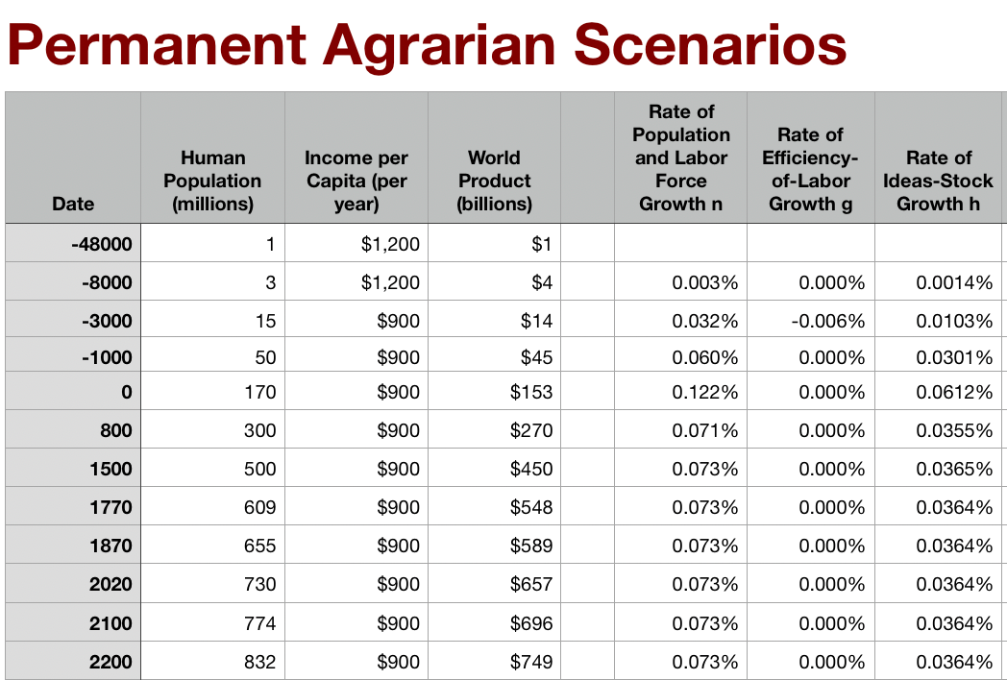
Permanent Agrarian Age World
What if there had been no Commercial Revolution?
What would we have to eliminate from our world?
The New World & the Columbian Exchange
Merchant republics & constitutional monarchies
Printing as transformative for intellectual life?
Is this plausible?
Rate of ideas growth settles at 0.035%/yr = 0.7%/generation
Doubling time of 2000 years
World today of 1/10 population, $2.50/day
Population growing at glacial pace

Slide 5
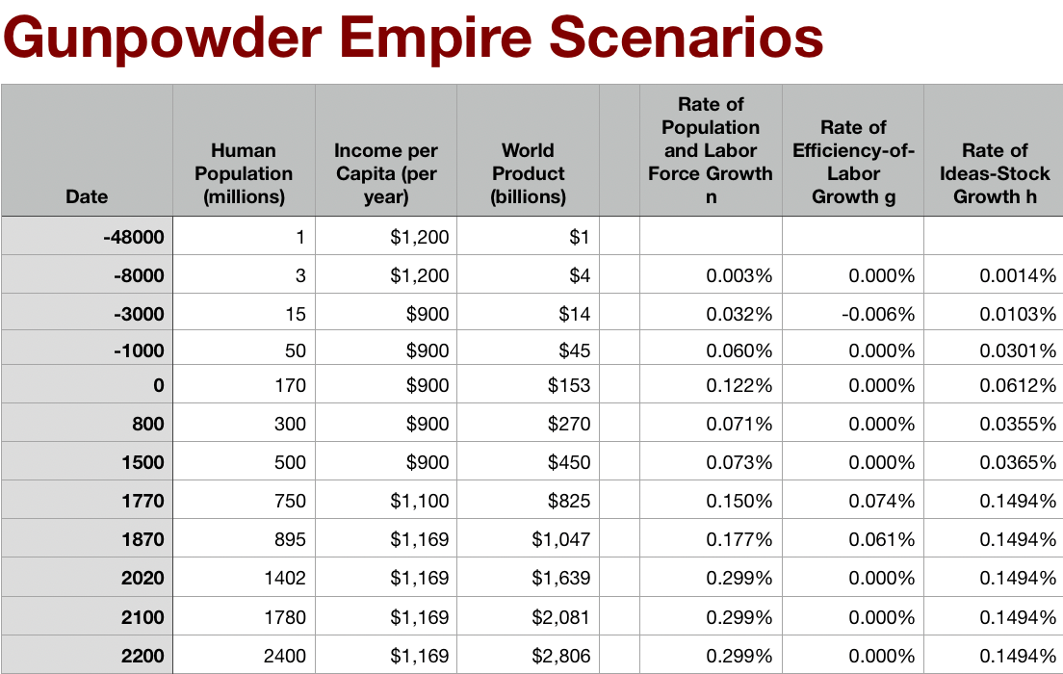
Gunpowder Empire World
What if things had stuck at the Commercial Revolution?
What would we have to eliminate from our world?
Coal or the British Empire
Science, tinkering, and nature manipulation?
Is this plausible?
Global rate of ideas growth of 0.15%/yr = 4%/generation, broadly shared
Doubling time of 500 years
World today of 1/5 our population, $3/day

Slide 6
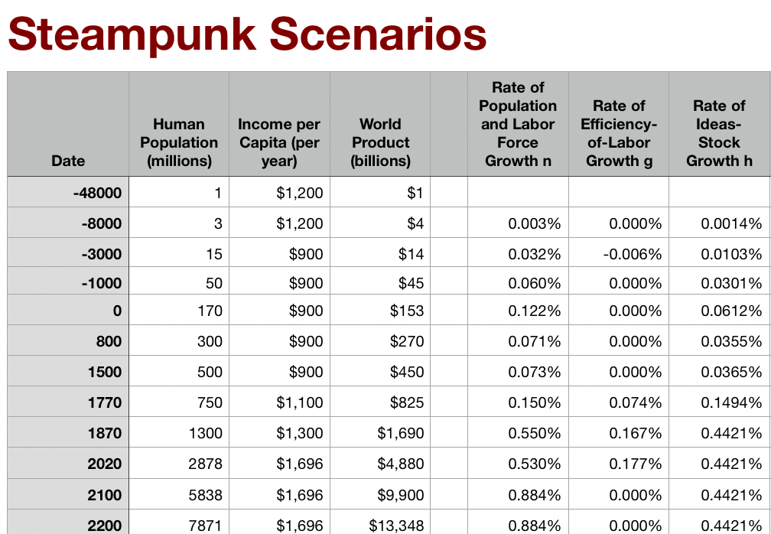
Steampunk World
What if there had been no Industrial Revolution?
What would we have to eliminate from our world?
Post-1870 speedup of STEM labor force growth
Industrial research lab to rationalize & routinize & modern corporation to deploy ideas
Globalization?
Is this plausible?
Stepping-on-toes & low-hanging-fruit
Arguments that it was inevitable lead to expectations of further growth accelerations—which we have not had
World settles at ideas growth of 0.44%/yr—12%/generation
doubling time of 150 years
World today of 2.7 billion, $5/day
World reaches today’s population in 2200

Slide 7
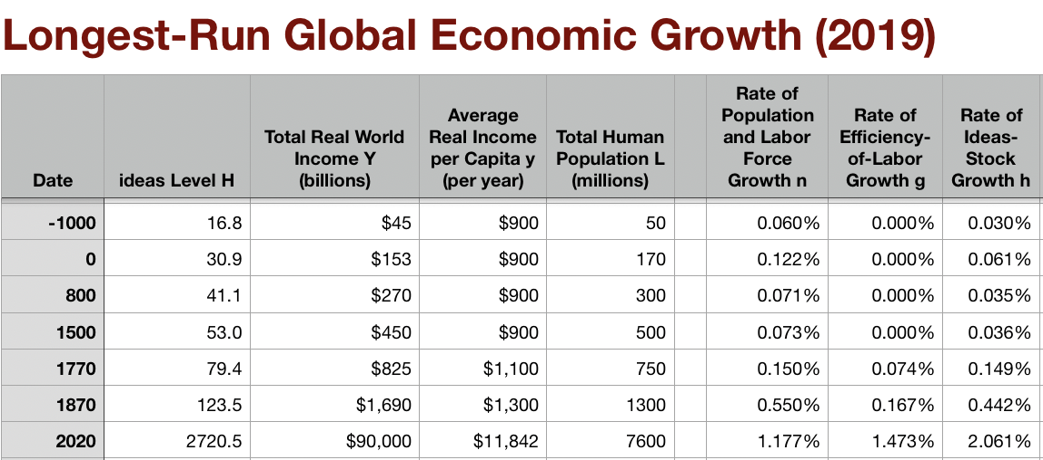
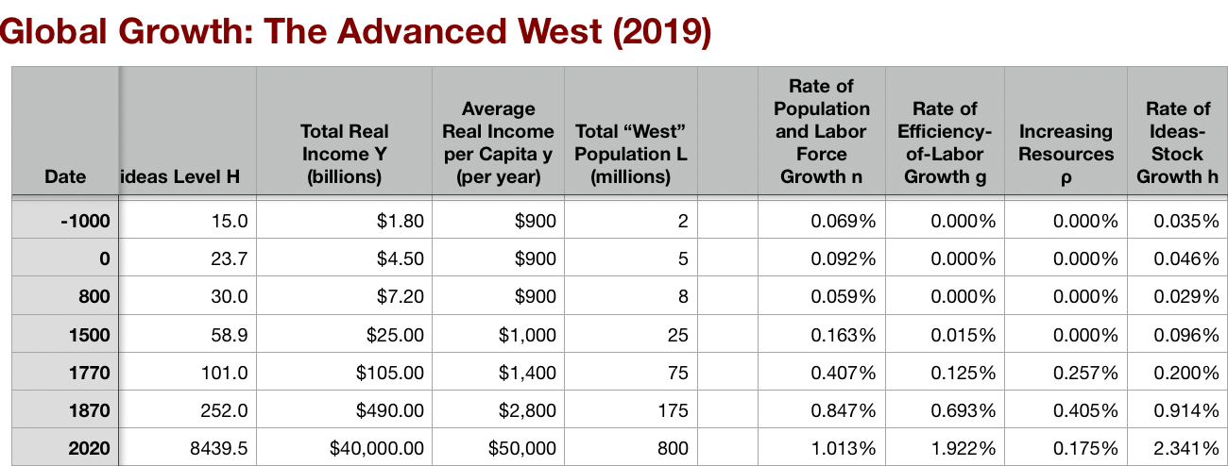
Those Are Not the Worlds We Live in
Modern Economic Growth:
We did have:
Industrial research lab: routinization & rationalization of invention & innovation
Modern corporation: routinization & rationalization of the deployment of ideas
Globalization
Transport
Communications
Migration
American ascendancy: “the furnace where the future is being forged”
Ideas growth of 2.1%/yr
Doubling time of 35 years
More change in one year than in 50
Enormous growth in global inequality

Slide 8
The World We Have: All That Is Solid Melts into Air
Since 1870: The Long 20th Century:
In all likelihood to be seen in the future as the watershed in human experience:
History was economic…
Explosion of wealth…
Cornucopia of technology…
Demographic transition…
Feminist revolution…
Empowered tyrannies…
Wealth gulfs…
Inclusion and hierarchy attenuation…
Mismanagement and insecurity…
Humanity is unlikely to see as transformative—for good and ill, but mostly for good—century again…

Slide 9
Shadows…
How many people today are still living on less than $2.50 a day?
70 million
230 million
700 million
2.3 billion

Slide 10
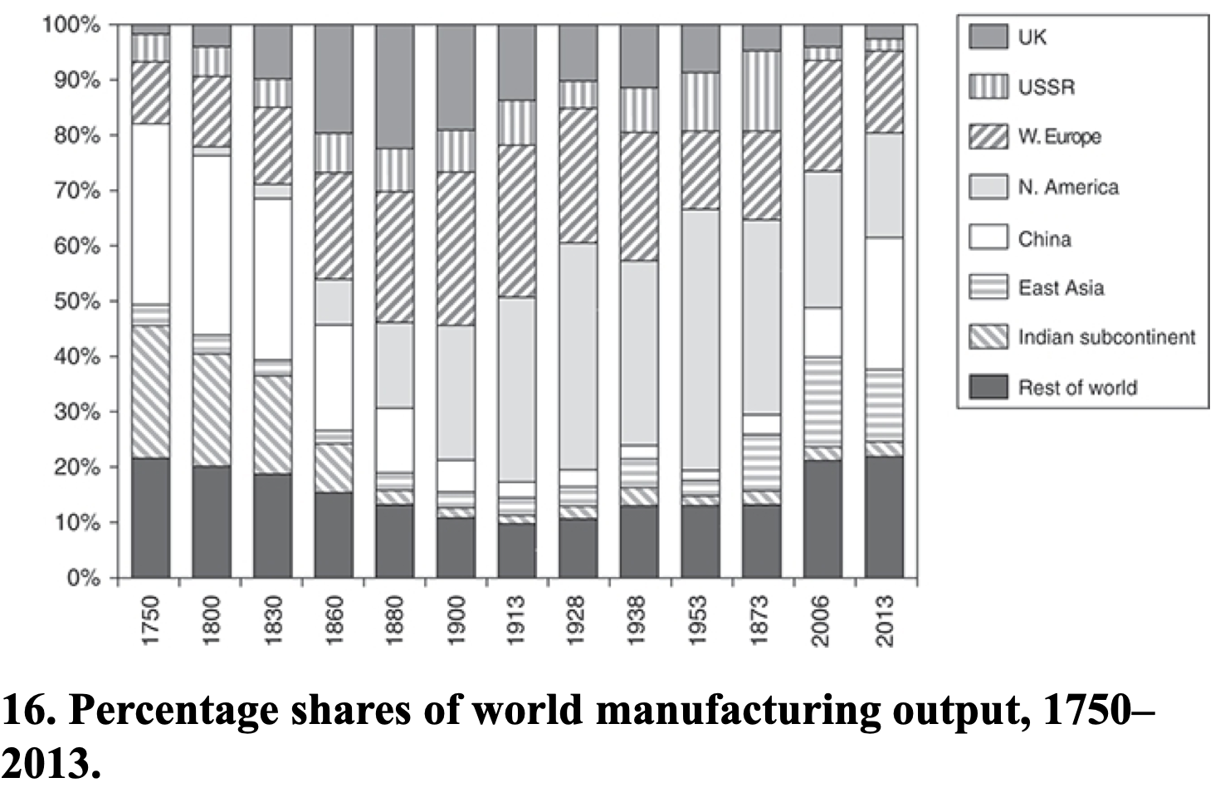
Allen: Spread of Industrialization
Robert Allen (2017): The Industrial Revolution: A Very Short Introduction <https://delong.typepad.com/files/allen-industrial.pdf>, chs. 3, 5-6:
Western Europe: 12% in the 18th century to 28% in 1913
North America: Less than 1% in the 18th century to 47% in 1953
The Pacific Rim share dropped from 4 per cent to 2 per cent in the early 19th century, but then increased to 5 percent in the first half of the 20th century. By 2006, these countries were producing 17 per cent of the world’s manufactures
China in 1953 at 2% of manufacturing was at its all time low. 9 per cent in 2006. 25 per cent in 2013
The Indian subcontinent: 2% of the world’s manufactures in 1973 and only 3% in 2013

Slide 11
Shadows…
What fraction of people today live in countries where average income per capita is greater than $40,000 per year?
50%
12%
5%
1.2%

Slide 12
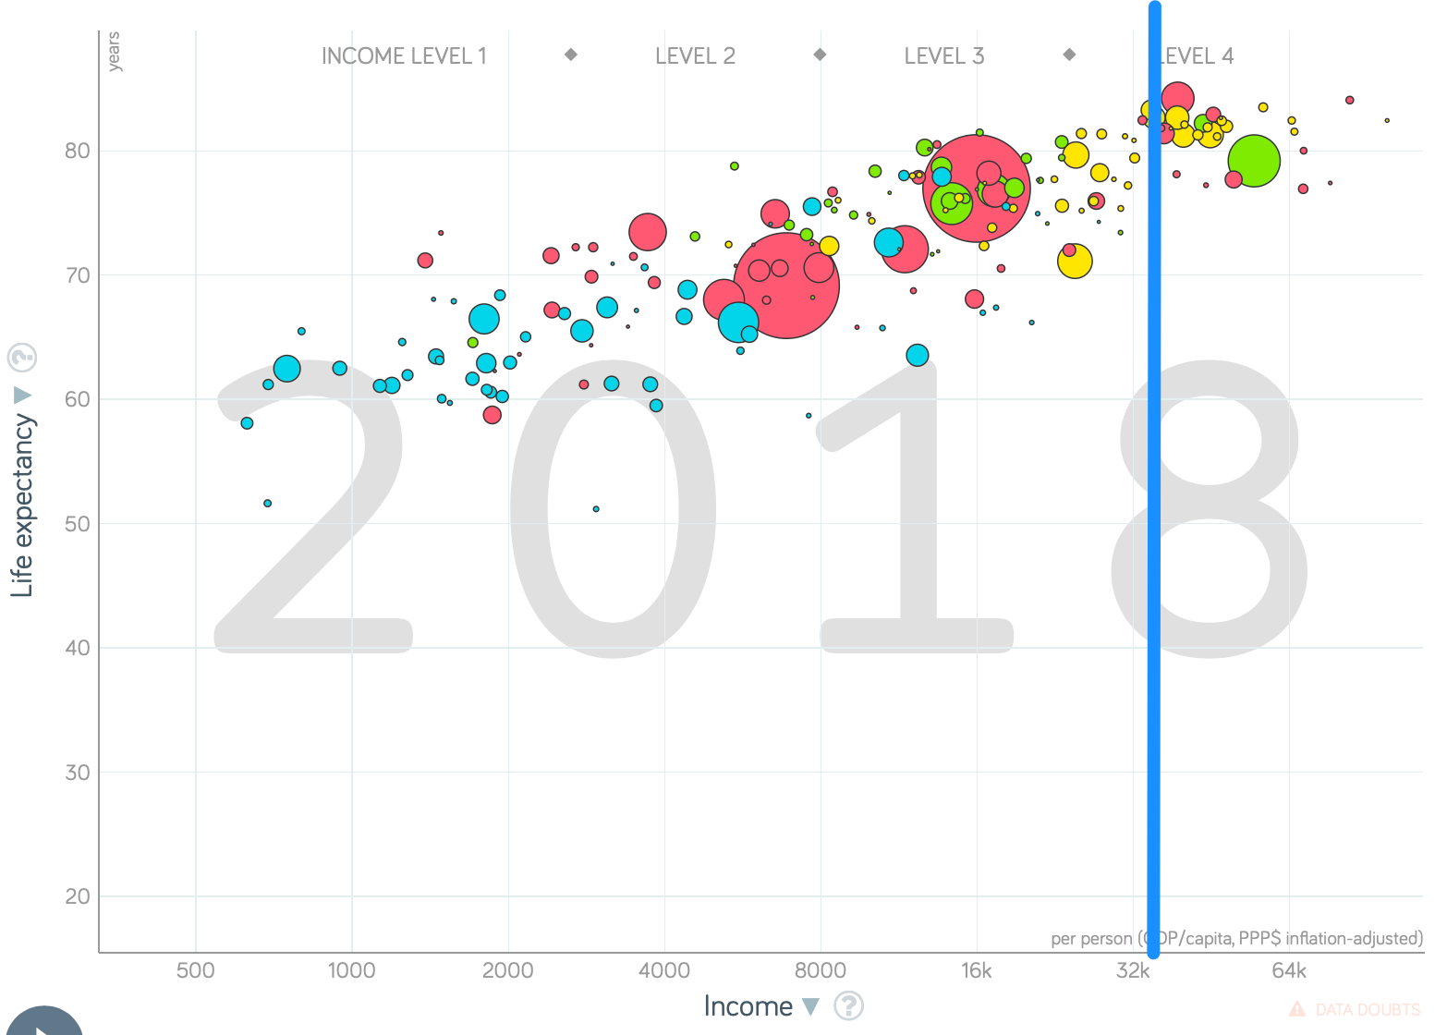
Shadows…
What fraction of people today live in countries where average income per capita is greater than $40,000 per year?

Slide 13

Edward Bellamy: Looking Backward
Edward Bellamy: Looking Backward <https://delong.typepad.com/files/bellamy-backward.pdf>: Perhaps the third best-selling novel of the 19th century in the United States
2000 is a utopia…
The narrator is carried forward in time from 1887-2000 by an implausible plot device:
‘“This is the tenth day of September in the year 2000, and you have slept exactly one hundred and thirteen years, three months, and eleven days…”’
He then wanders around, looking at the utopia of 2000…
The opening:
‘“How could I live without service to the world?” you ask…. The answer is that my great-grandfather had accumulated a sum of money on which his descendants had ever since…. The sum had been originally by no means large. It was, in fact, much larger now that three generations had been supported upon it in idleness, than it was at first…’

Slide 14
The Stagecoach of Society
Those who ride and this who pull:
‘Commiseration was frequently expressed by those who rode for those who had to pull the coach, especially when the vehicle came to a bad place in the road, as it was constantly doing, or to a particularly steep hill. At such times, the desperate straining of the team, their agonized leaping and plunging under the pitiless lashing of hunger, the many who fainted at the rope and were trampled in the mire, made a very distressing spectacle, which often called forth highly creditable displays of feeling on the top of the coach.
‘At such times the passengers would call down encouragingly to the toilers of the rope, exhorting them to patience, and holding out hopes of possible compensation in another world for the hardness of their lot, while others contributed to buy salves and liniments for the crippled and injured. It was agreed that it was a great pity that the coach should be so hard to pull, and there was a sense of general relief when the specially bad piece of road was gotten over. This relief was not, indeed, wholly on account of the team, for there was always some danger at these bad places of a general overturn in which all would lose their seats.
‘It must in truth be admitted that the main effect of the spectacle of the misery of the toilers at the rope was to enhance the passengers’ sense of the value of their seats upon the coach, and to cause them to hold on to them more desperately than before…

Slide 15
The Stagecoach of Society II
“Finer clay”:
‘The other fact is yet more curious, consisting in a singular hallucination which those on the top of the coach generally shared, that they were not exactly like their brothers and sisters who pulled at the rope, but of finer clay, in some way belonging to a higher order of beings who might justly expect to be drawn. This seems unaccountable, but, as I once rode on this very coach and shared that very hallucination, I ought to be believed.
‘The strangest thing about the hallucination was that those who had but just climbed up from the ground, before they had outgrown the marks of the rope upon their hands, began to fall under its influence. As for those whose parents and grand-parents before them had been so fortunate as to keep their seats on the top, the conviction they cherished of the essential difference between their sort of humanity and the common article was absolute. The effect of such a delusion in moderating fellow feeling for the sufferings of the mass of men into a distant and philosophical compassion is obvious.
‘To it I refer as the only extenuation I can offer for the indifference which, at the period I write of, marked my own attitude toward the misery of my brothers…

Slide 16
The Stagecoach of Society III
Class war:
‘The sanguine argued very forcibly that it was in the very nature of things impossible that the new hopes of the workingmen could be satisfied, simply because the world had not the wherewithal to satisfy them. It was only because the masses worked very hard and lived on short commons that the race did not starve outright, and no considerable improvement in their condition was possible while the world, as a whole, remained so poor.
‘It was not the capitalists whom the laboring men were contending with, these maintained, but the iron-bound environment of humanity, and it was merely a question of the thickness of their skulls when they would discover the fact and make up their minds to endure what they could not cure.
The less sanguine admitted all this. Of course the workingmen’s aspirations were impossible of fulfillment for natural reasons, but there were grounds to fear that they would not discover this fact until they had made a sad mess of society. They had the votes and the power to do so if they pleased, and their leaders meant they should. Some of these desponding observers went so far as to predict an impending social cataclysm. Humanity, they argued, having climbed to the top round of the ladder of civilization, was about to take a header into chaos…’

Slide 17
The Limit of Human Felicity
Technological marvels of 2000: great cities, Amazon drop-shipments, music
Julian West expects Edith Leete to play the piano, but:
‘“Nothing would delight me so much as to listen to you,” I said.
‘“To me!” she exclaimed, laughing. “Did you think I was going to play or sing to you?”
‘“I hoped so, certainly,” I replied.
‘Seeing that I was a little abashed, she subdued her merriment and explained. “Of course, we all sing nowadays as a matter of course in the training of the voice, and some learn to play instruments for their private amusement; but the professional music is so much grander and more perfect than any performance of ours, and so easily com- manded when we wish to hear it, that we don’t think of calling our singing or playing music at all. All the really fine singers and players are in the musical service, and the rest of us hold our peace for the main part. But would you really like to hear some music?”…’

Slide 18
The Limit of Human Felicity II
In the music room:
‘She made me sit down comfortably, and, crossing the room, so far as I could see, merely touched one or two screws, and at once the room was filled with the music of a grand organ anthem; filled, not flooded, for, by some means, the volume of melody had been per- fectly graduated to the size of the apartment. I listened, scarcely breathing, to the close. Such music, so perfectly rendered, I had never expected to hear.
‘“Grand!” I cried, as the last great wave of sound broke and ebbed away into silence. “Bach must be at the keys of that organ; but where is the organ?”…
‘“There are a number of music rooms in the city, perfectly adapted acoustically to the different sorts of music. These halls are connected by telephone with all the houses of the city…. Any one of the four pieces now going on that you prefer, you can hear by merely pressing the button which will connect your house-wire with the hall where it is being rendered…”’

Slide 19
The Limit of Human Felicity III
Four live orchestras you can listen to on the speakerphone!
‘“It appears to me, Miss Leete,” I said, “that if we could have devised an arrangement for providing everybody with music in their homes, perfect in quality, unlimited in quantity, suited to every mood, and beginning and ceasing at will, we should have considered the limit of human felicity already attained, and ceased to strive for further improvements…”’

Slide 20
Feminism
The elimination of housework—and of the servant class:
‘“Who does your house-work, then?” I asked.
‘“There is none to do,” said Mrs. Leete.… “Our washing is all done at public laundries at exces- sively cheap rates, and our cooking at public kitchens. The making and repairing of all we wear are done outside in public shops. Elec- tricity,* of course, takes the place of all fires and lighting. We choose houses no larger than we need, and furnish them so as to involve the minimum of trouble to keep them in order. We have no use for domestic servants….
‘“What a paradise for womankind the world must be now!” I exclaimed. “In my day, even wealth and unlimited servants did not enfranchise their possessors from household cares, while the women of the merely well-to-do and poorer classes lived and died martyrs to them…”’

Slide 21
The View from 3000: Themes & Big Ideas
Science reaches critical mass and from it springs engineering—all of the engineering subdisciplines, including the management of human resources and of organizations. From a liberal political order spring national and then the global market economy. And from engineering and the market then, since 1870, spring…
Post-1870 history has been economic…
Explosion of wealth…
Cornucopia of technology…
Demographic transition…
Feminist revolution…
Empowered tyrannies…
Wealth gulfs…
Inclusion and hierarchy attenuation…
Mismanagement and insecurity…

Slide 22
Modern Economic Growth
Modern Economic Growth <https://www.icloud.com/keynote/0cAkr6Xg2irxSX4uEtqSShI-Q>
Modern Economic Growth: Eagle’s-Eye View <https://www.icloud.com/keynote/0uV-761YfOFH171v7LfWSaraA>
Future Duration of Modern Economic Growth <https://www.icloud.com/keynote/0-YJu0G3OfHNBAdgdO7ACJ-rw>
Readings: Modern Economic Growth <https://www.icloud.com/keynote/0-eFajZd43DYDqAqDnBfRqeLA>
Article: Nordhaus: History of Lighting <https://www.icloud.com/keynote/0dc5gmnPPBwdqXx-Ql3i-hEaQ>
Article: Donaldson: Railways of the Raj <https://www.icloud.com/keynote/0qBZ2I5FNs-WmpuCh_lZHOurw>
Article: Thompson: Liberty Shipbuilders <https://www.icloud.com/keynote/0bwURhbpD_r3yp9L2Y4CNLW2A>
Article: Crafts: The Solow Productivity Paradox in Historical Perspective https://www.icloud.com/keynote/0tR_-udvdJau_fkmiItCzxmCQ
Article: Nathan Nunn (2008): The Long-Term Effects of Africa’s Slave Trades https://www.icloud.com/keynote/06pkCtAWbjBWAijow41dM1XAQ
African Retardation <https://www.icloud.com/keynote/0O8TxLOzM1gvGwSZYkWBV97rw>
Article: Nathan Nunn (2008): The Long-Term Effects of Africa’s Slave Trades https://www.icloud.com/keynote/06pkCtAWbjBWAijow41dM1XAQ https://www.icloud.com/keynote/06pkCtAWbjBWAijow41dM1XAQ
Modern Economic Growth Memo Question <https://www.icloud.com/keynote/0ElT1DF6p0hpO991Wx0CTDJAQ>

Slide 23
The Eagle’s-Eye View
Three accelerations:
6.5-fold with the Commercial Revolution
3.5-fold with the Industrial Revolution
4.5-fold with the coming of Modern Economic Growth
Back when I got into this business in the 1980s Paul Romer was making what seemed to us to be powerful arguments that there was about to be a fourth acceleration
Did not happen (yet)
Everything logisticizes…

Slide 24
MEG: Origin, Pace, Spread, Duration(?)
Origin:
We have market economies in Eurasia, at least, from 500 BC.
We have governments smart enough—or constrained enough—not to kill the goose that lays the golden eggs, at least not quickly.
Yet post-1770 and much more so post-1870 we have something truly wild—but also oddly concentrated
Pace:
How fast has it been, really?
Do quantitative indices of output per capita calculated over extended periods of time have any meaning?
How many “singularities” or near-“singularities”?

Slide 25
MEG: The Question of Spread…
Karl Marx (1853): “The Future Results of British Rule in India” https://marxists.catbull.com/archive/marx/works/1853/07/22.htm :
“The millocracy… intend now drawing a net of railroads over India….
“You cannot maintain a net of railways over an immense country without introducing all those industrial processes necessary to meet the immediate and current wants of railway locomotion, and out of which there must grow the application of machinery to those branches of industry not immediately connected with railways. The railway-system will therefore become, in India, truly the forerunner of modern industry….
“What they will not fail to do is to lay down the material premises.…
“Has the bourgeoisie ever done more? Has it ever effected a progress without dragging individuals and people through blood and dirt, through misery and degradation?…”

Slide 26
Marx Is Trying…
Karl Marx (1853): “The Future Results of British Rule in India” https://marxists.catbull.com/archive/marx/works/1853/07/22.htm :
“The Indians will not reap the fruits of the new elements of society scattered among them by the British bourgeoisie, till in Great Britain itself the now ruling classes shall have been supplanted by the industrial proletariat, or till the Hindoos themselves shall have grown strong enough to throw off the English yoke altogether.
“At all events, we may safely expect to see, at a more or less remote period, the regeneration of that great and interesting country, whose gentle natives are, to use the expression of Prince Soltykov, even in the most inferior classes, ‘plus fins et plus adroits que les Italiens’, a whose submission even is counterbalanced by a certain calm nobility, who, notwithstanding their natural langor, have astonished the British officers by their bravery, whose country has been the source of our languages, our religions, and who represent the type of the ancient German in the Jat, and the type of the ancient Greek in the Brahmin….
“The profound hypocrisy and inherent barbarism of bourgeois civilization lies unveiled before our eyes, turning from its home, where it assumes respectable forms, to the colonies, where it goes naked. They are the defenders of property, but did any revolutionary party ever originate agrarian revolutions like those in Bengal, in Madras, and in Bombay? Did they not, in India, to borrow an expression of. that great robber, Lord Clive himself, resort to atrocious extortion, when simple corruption could not keep pace with their rapacity?…
“Bourgeois industry and commerce create these material conditions of a new world in the same way as geological revolutions have created the surface of the earth. When a great social revolution shall have mastered the results of the bourgeois epoch, the market of the world and the modern powers of production, and subjected them to the common control of the most advanced peoples, then only will human progress cease to resemble that hideous, pagan idol, who would not drink the nectar but from the skulls of the slain…”

Slide 27
MEG: Spread II
Economic inequality and its “between nations” and “within nations” components
Spread of MEG:
Starts as Greater London, Amsterdam, and Antwerp, plus American north ports, plus British Midlands, Belgian resource-rich, New England
Spreads via enclaves, settlement, cultural transmission
We wind up with a “First World” of Marshall-Plan recipients and donors, plus Korea, Taiwan (PoC), Hong Kong (SAZ), and Singapore…
Qian Yingyi: “neocolonial origins of comparative development”…
Elsewhere:
“Recent settlement”—S. Brazil, Southern Cone, Ukraine frontier, Ghana-Kenya-Zambia-Zimbabwe-South Africa…
Sub-Saharan Africa
Stalinist Central Planning…
“Meh” RoW…

Slide 28
MEG: Is Spread Changing? III
Richard Baldwin’s take: from The Great Convergence:
Separation of production and consumption… first unbundling.... Markets expanded globally but industry clustered…. Northern industrialization fostered Northern innovation, and since ideas were so costly to move, Northern innovations stayed in the North…. The resulting growth differences compounded into the colossal, North-South income asymmetries that define the planet’s economic landscape even today…. The Great Divergence was produced by the combination of low trade costs and high communication costs…
Concentrated shift of manufacturing to six low wage economies, the I6: China, Korea, India, Indonesia, Thailand, and Poland…
The commodity price boom created by growth in the I6 then pulls other resource rich economies up: Australia, Mexico, Brazil, Nigeria, Venezuela, Turkey…

Slide 29
MEG: Duration(?) IV
Duration: Everything logisticizes, eventually: Gordon vs. Varian
Gordon: it’s all about: matter manipulation, power generation and application, and flush toilets—and that’s all over…
Varian: we combine: physical stuff, energy applied to matter-manipulation, information, and communication to generate utility—and that’s just beginning…

Slide 30
MEG: What Do We Have to Account for?
1.8%-point/year jump in ideas proportional generation rate h…
0.018 x 150 = 2.7 in the natural log…
How would we go about looking for what are the components of this jump relative to even the Industrial Revolution-era immediate past?
How would we go about looking for what are the components of this jump relative to economies that fall behind?

Slide 31

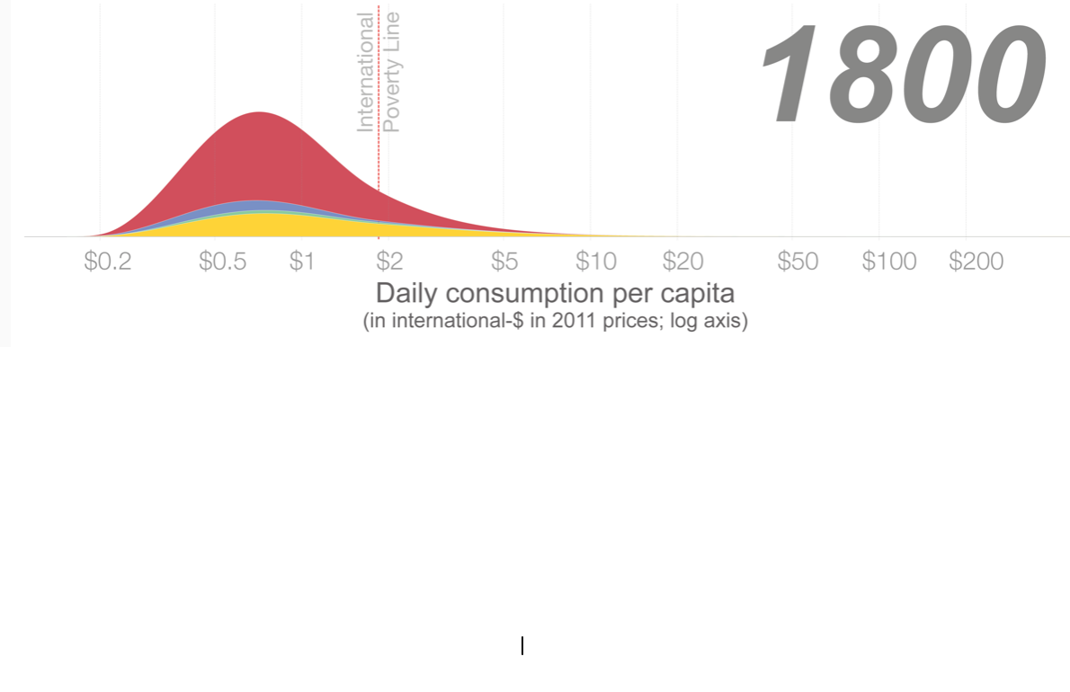
World Income Distribution: 1800
Bulk of world’s population at or below $2/day (these numbers are about 2/3 of those in the previous slides)…

Slide 32
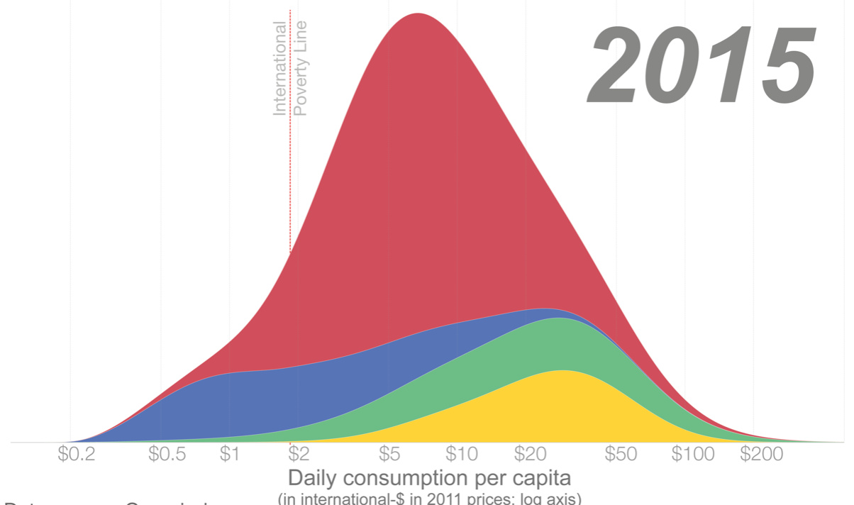
World Income Distribution: 2015
Less than 750 million people below $1.33/day—what we set our Malthusian subsistence level at…

Slide 33
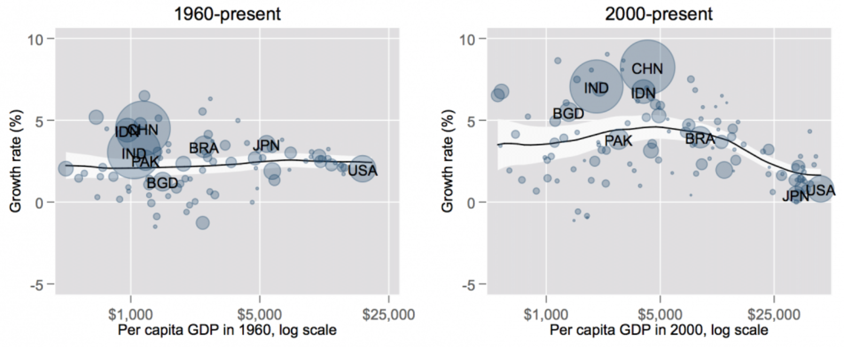
Was There a Sea-Sea-Change Around 1980?
I say yes—but only for China and, a bit later, for India and Indonesia (Bangladesh?)…
Plus post-2000 crash of the OECD…

Slide 34
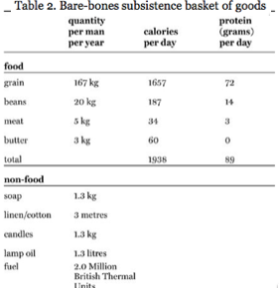
A Dollar a Day
What do you get for $1/day?
Robert Allen’s subsistence baskets
Is this enough to ovulate?
What with famines, accidents, plagues, etc., pre-industrial populations living on $1/day survive but shrink

Slide 35
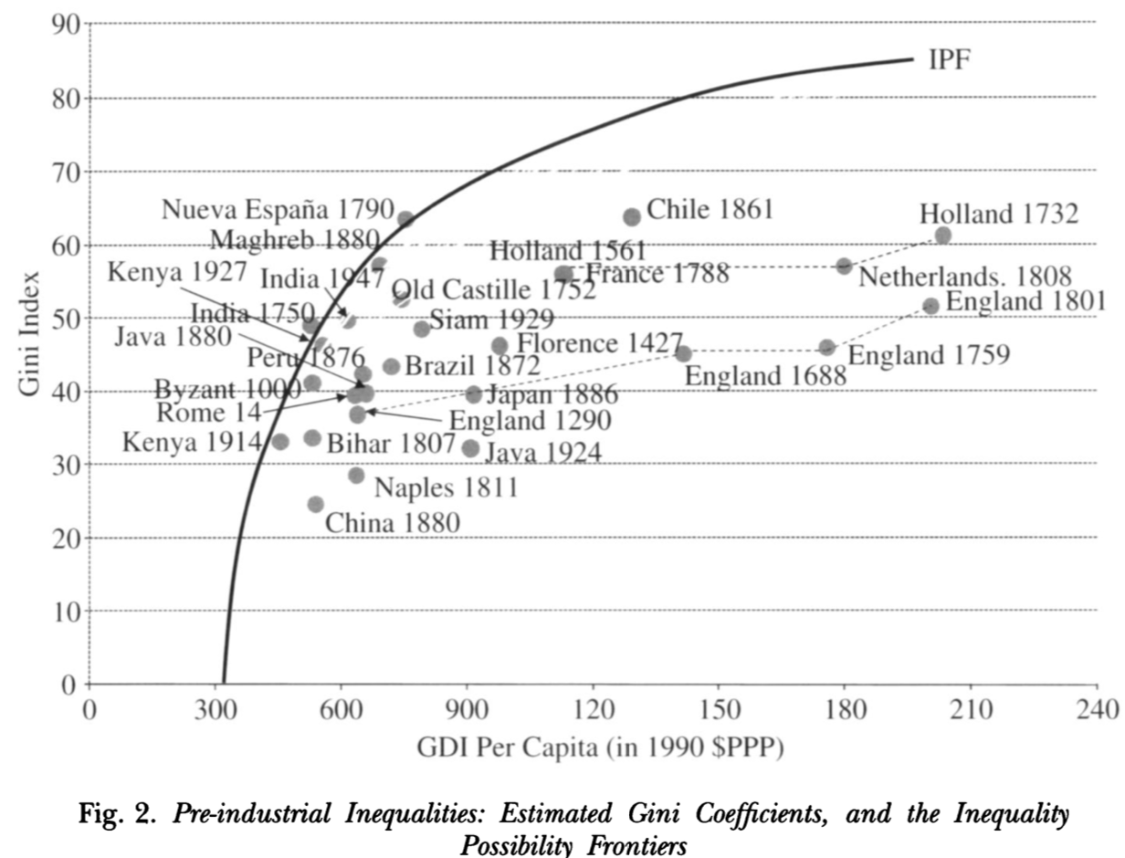
Pre-1800 Income Inequality
High-Malthusian societies…
Globalizing societies…
Gini coefficients: one of the deceptions of Satan…
If the bottom 3/4 got 1/4 of the income and the top 1/4 the rest (evenly distributed)—i.e., 80-20 ratio = 9, the Gini would be 0.5 (50%)
If the bottom 2/3 got 1/3 of the income and the top 1/3 the rest (evenly distributed)—i.e., 80-20 ratio = 4—the Gini would be 0.33 (33%)
This is income: not status or social power: the 4M slaves in the U.S. in 1860 would have objected most strongly to claim that U.S. then no more unequal than Britain…
If you were to think like a utilitarian—and assume that each doubling of income is equally valuable in a utilitarian sense—a move from a Gini of 0.5 to 0.33 would be like a 30% boost to everyone’s income…
U.S, Gini today 0.41?

Slide 36
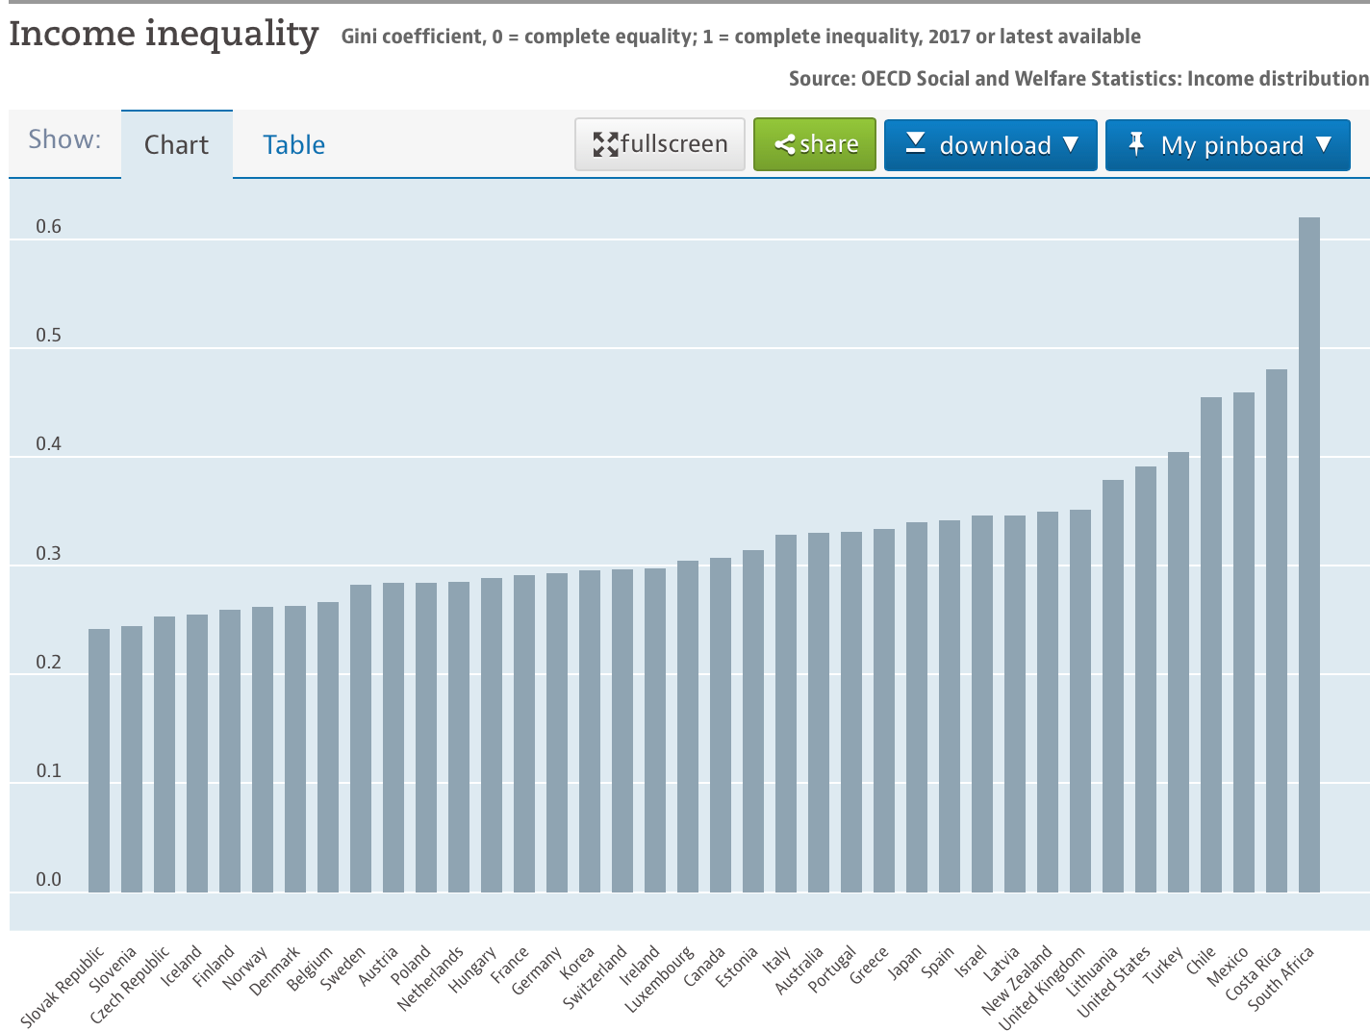
Gini Coefficients Today

Slide 37
The Rich of the Past…
1770: 750M people; mean lifetime income/consumption $900/yr
x 25 —$360/yr
x 15…
Pareto’s Law; 20% get 80% (Pareto distribution with α = 1.16)
Full Berkeley economics professors… $240K/yr
In 1770:
Top 100M got $1500/yr
Top 20M got $6000/yr
Top 4M got $24K/yr
Top 800K got $120K/yr
Top 160K got $480K/yr
Top 32K got $2M/yr
Top 6K got $8M/yr

Slide 38
What Determines Rich and Poor Economies?
In the 19th Century: Standard package:
(Manufacturing) tariffs, railroads (and ports), banks, schools…
“Culture”
In the 20th Century: “Big pushes”?
Northwest European settlement
Marshall Plan (and Asian “neocolonial origins”
Really-existing socialism
Africa (but post 1950…)

Slide 39
Future Duration of Modern Economic Growth
Gordon vs. Varian
Gordon: it’s all about:
matter manipulation,
power generation and application, and
flush toilets—and
that’s allover…
Varian: we combine:
physical stuff,
energy applied to matter-manipulation,
information, and
communication
to generate utility—and
that’s just beginning…

Slide 40
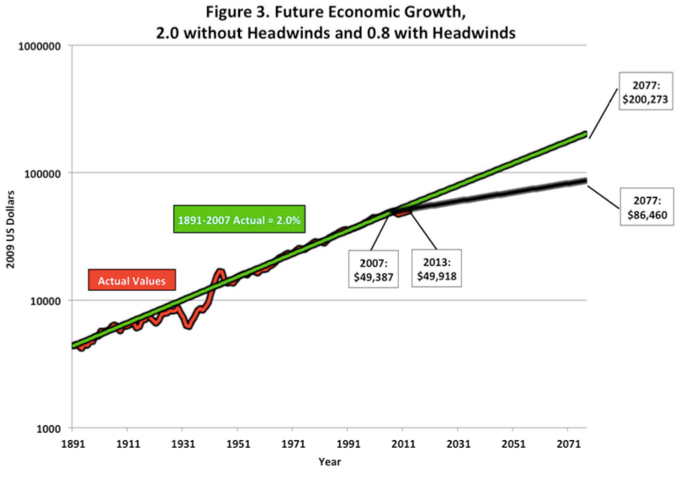
Bob Gordon: Technological Exhaustion Occurred Forty Years Ago
Robert J. Gordon. 2014. “The Demise of U.S. Economic Growth: Restatement, Rebuttal, and Reflections.” NBER Working Paper No. 19895 (February). www.nber.org/papers/w19895
“There is no need to forecast that innovation in the future will ‘falter’…. The slowdown in the rate of productivity growth… occurred more than four decades ago….
“[My] forecast assumes that innovations in the next 40 years will be developed at the same pace as the last four decades, but reasons for skepticism are provided for that prediction….
“The… 1870 and 1900, with continuing benefits to 1972… “Second Industrial Revolution” (IR #2)…. growth rate of American productivity… [of] 2.36 percent per year, compared to 1.59 percent per year since 1972. That permanent decline of 0.8[%-points]… measure[s] the extent to which the single-dimension digital “Third Industrial Revolution” (IR #3) has fallen short of the multi-dimensional IR #2…

Slide 41
Bob Gordon: Power and Matter Manipulation and Flush Toilets
Modern Economic Growth ain’t going to continue
It’s really all about:
Nonhuman combustion-based energy sources
Use of energy and automatic machinery for matter manipulation
Flush toilets
Everything else that is important is subject to Baumol’s disease
The Trachtenberg/Nordhaus counter…
The Varian counter…

Slide 42
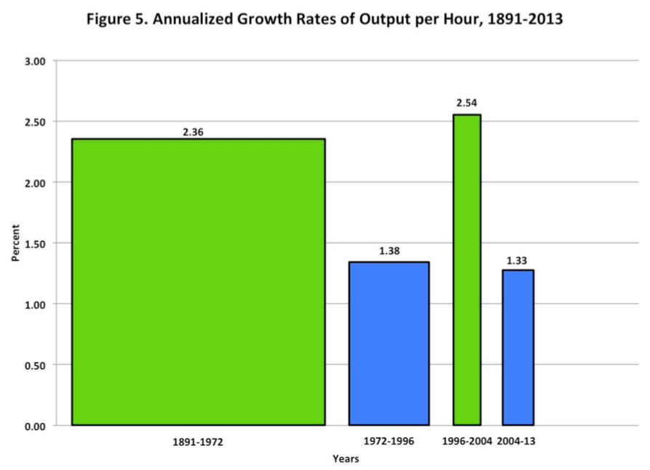
Bob Gordon: 1996-2004 a Flash in the Pan
Modern Economic Growth ain’t going to continue at its 1890-1972 pace
In what ways is 2004-13 unrepresentative of the future?
How would we figure out whether 1996-2004 or 1972-1996 is more likely going forward?

Slide 43
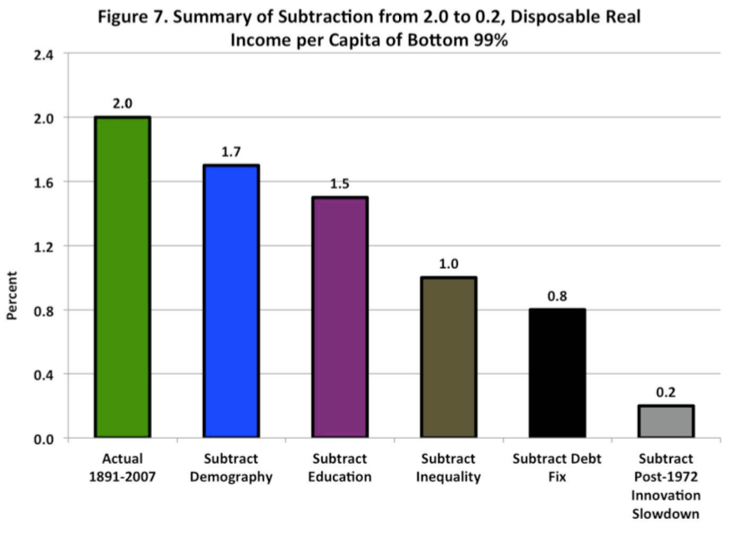
Bob Gordon: “Headwinds”
Modern Economic Growth ain’t going to continue at its 1890-1972 pace
Demography yes…
But education, inequality, “debt fix”?
Gordon is greatly widening his critique beyond the uniqueness of IR#2

Slide 44
Bob Gordon: The Eighty Years Before 1890
In October, 1879, Thomas Edison created the first working electric light bulb…
Between 1890 and 1930 the American household became fully “networked,” replacing its previous isolation by five types of connections – electricity, gas, telephone, running water, and sewer pipes….
Two months after Edison’s electric light, Karl Benz achieved the first reliable and workable internal combustion engine…
An Englishman named David Edward Hughes succeeded in sending a wireless signal several hundred meters in London almost two decades before Marconi won his earliest wireless patents
At least three aspects of the Second Industrial Revolution have received less attention than they deserve… the multi-dimensional nature… everything happened all at once…. economic progress through 1972 mainly consisted of consolidating the incomplete aspects of IR #2 across many subsidiary and complementary inventions….
Two criteria help to capture the uniqueness of IR#2. First, something cannot be more than 100 percent…. The second … some indicators cannot go below zero…

Slide 45
Bob Gordon: The Next Forty Years
As we peer out into the future, the achievements of the past 40 years set a hurdle that is dauntingly high.
The achievements that must be matched for importance in the next four decades include:
Memory typewriters, the personal computer, word-processing and spreadsheets
Bar-code scanning, ATM banking, cable and satellite TV
Internet, e-mail, web browsing, e-commerce
Google, Amazon, Wikipedia, Linked-In, Facebook
Mobile phones, smart phones, ipads
CDs, DVDs, i-tunes, Netflix, movie streaming
Airline reservation systems, supply-chain monitoring systems, electronic library catalogs
What is in store for the next 40 years?

Slide 46
Bill Nordhaus: History of Lighting
William D. Nordhaus. 1997. “Do Real-Output and Real-Wage Measures Capture Reality? The History of Lighting Suggests Not.” In The Economics of New Goods, edited by Timothy F. Bresnahan and Robert J. Gordon. Chicago: University of Chicago Press for NBER, pp. 29– 66. http://www.nber.org/chapters/c6064 | <http://tinyurl.com/dl2017201a>

Slide 47
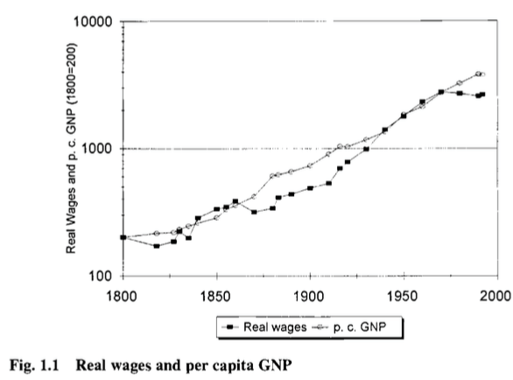
Bill Nordhaus: Measured Real Productivity
William D. Nordhaus. 1997. “Do Real-Output and Real-Wage Measures Capture Reality? The History of Lighting Suggests Not.” In The Economics of New Goods, edited by Timothy F. Bresnahan and Robert J. Gordon. Chicago: University of Chicago Press for NBER, pp. 29– 66. http://www.nber.org/chapters/c6064
Conventional measures: a 15-fold increase in real first-world GDP/capita and productivity

Slide 48
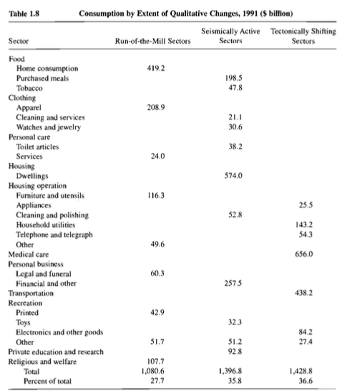
Bill Nordhaus: Rocket Ship to the Singularity?
A 20-fold or a 30,000-fold increase in real wages in the North Atlantic since 1800?
Nordhaus calculates that—back in 1991—28% of consumption was “run-of-the-mill”, 36% had been “seismically-active” since 1800, and 37% was in sectors that had no effective affordable equivalent in 1800
Dixit-Stiglitz tells us that we multiply “ordinary” utilities by the number of varieties. Which way does that mislead us?

Slide 49
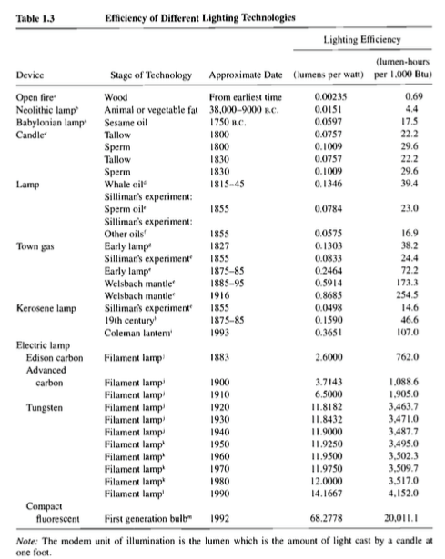
Bill Nordhaus: Rocket Ship to the Singularity II
A 5000-fold decrease in the price of light since 1800
This is something that churned up between 1% and 5% of household budgets back in 1800
100-fold CPI bias in the price of light since 1800

Slide 50
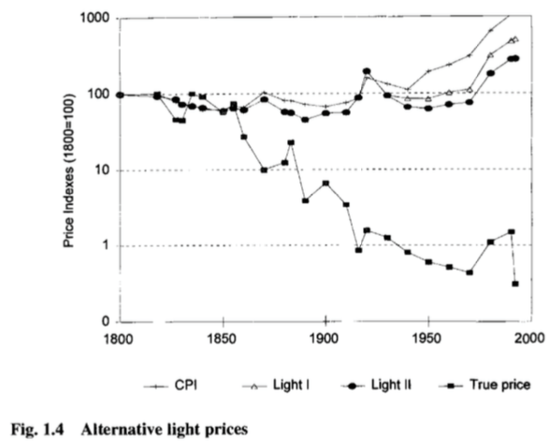
Bill Nordhaus: Rocket Ship to the Singularity III
A 5000-fold decrease in the price of light since 1800
This is something that churned up between 1% and 5% of household budgets back in 1800
100-fold CPI bias in the price of light since 1800

Slide 51
Discussion
Modern Economic Growth:
What do we think of alternatives to Allen’s story?
10:35-10:50

Slide 52
Big Ideas: Lecture 12: Modern Economic Growth
Takeaways from this class:

Slide 53
Catch Our Breath…
Ask a couple of questions?
Make a couple of comments?
Any more readings to recommend?

Slide 54
Notes

Slide 55
Reviews…

Slide 56
Review: Commercial Revolutions
Exploration and Conquest and Market Extension:
Zheng He: 1405-33: 7 expeditions—300 ships ??, 30,000 crew??, as far as Malindi. 400 feet long??:
“We have traversed more than 100,000 li of immense water spaces and have beheld in the ocean huge waves like mountains rising in the sky, and we have set eyes on barbarian regions far away hidden in a blue transparency of light vapors, while our sails, loftily unfurled like clouds day and night, continued their course [as rapidly] as a star, traversing those savage waves as if we were treading a public thoroughfare…”, quoted in Louise Levathes (1996): When China Ruled the Seas: The Treasure Fleet of the Dragon Throne, 1405–1433
Bartolomeu Dias: 1487-8: 3 ships, rounded the Cape of Good Hope at the southern tip of Africa. 80 feet long, 30 men/ship
Cristoforo Colombo: 1492: 3 ships, 90 men.
Vasco da Gama: 1498: 4 ships, 170 men to India and back
9:45-10:00

Slide 57
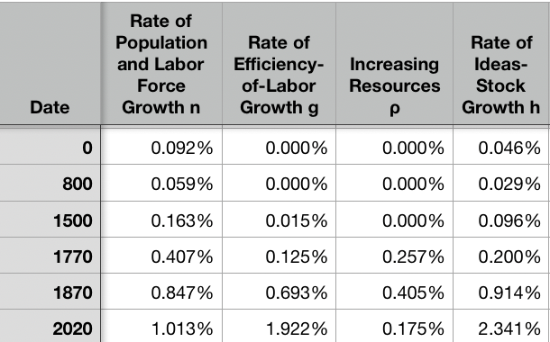
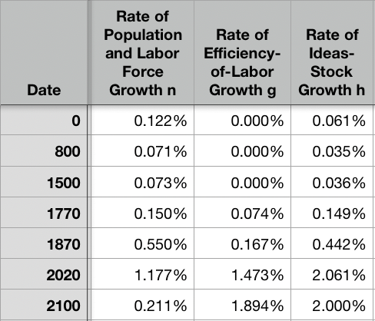
Resources! And Political Economy!
“The Advanced West”
The Columbian Exchange
Corn, the potato, chocolate, &c.: substantial boost to calories
Benefits everywhere!
But one-sided: Europe gains empire and resources wherever its ships can sail and cannon can shoot
Sugar islands and the slave trade
400 calories per Briton per day by 1750?
The underdevelopment of Africa
12.5 million Atlantic African slave trade
(2 million Mediterranean, 4 million Black Sea, 1 million Viking, 17 million Indian Ocean, 30 million Graeco-Roman)
The East Indies
Spices—later silks, porcelain, cottons: 80% fall in real price
Benefits everywhere
But benefits one-sided: disassembling a mountain of silver in Peru in order to import luxuries from China, India, Malaysia, and Indonesia…
Political Economy
The merchants of Bristol, the nabobs, the King of Spain: New wealth to add in to the scales…
Inflation
The World
9:45-10:00

Slide 58
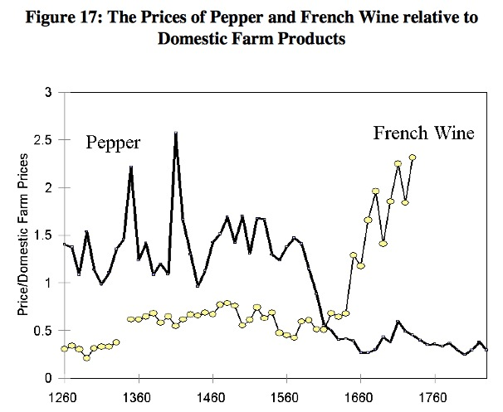
Clark, “The Secret History of the Industrial Revolution”
9:45-10:00

Slide 59
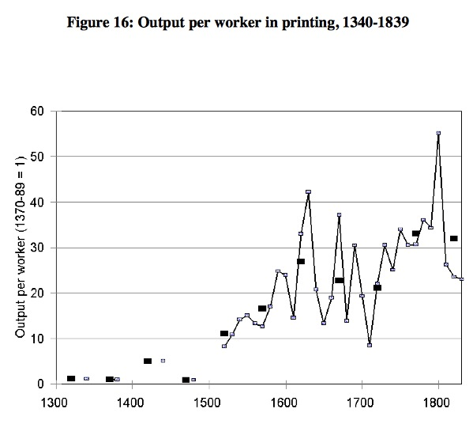
Clark, “The Secret History of the Industrial Revolution”
9:45-10:00

Slide 60
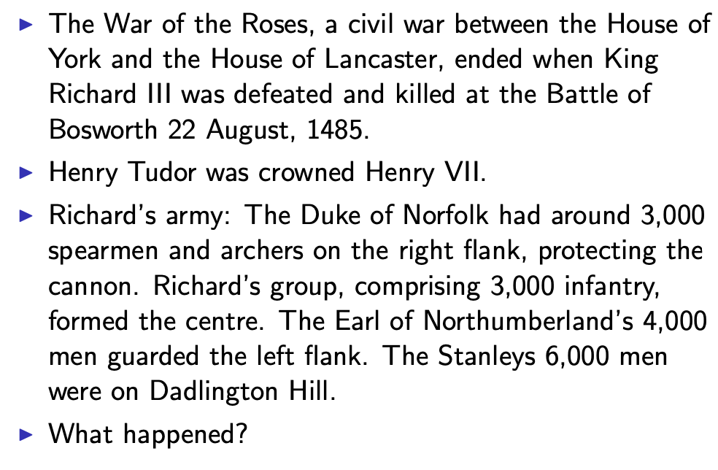
Establishing an Effective Monopoly of Violence: Wars of the Roses
10:10-10:20
Slide taken from Melissa Dell

Slide 61
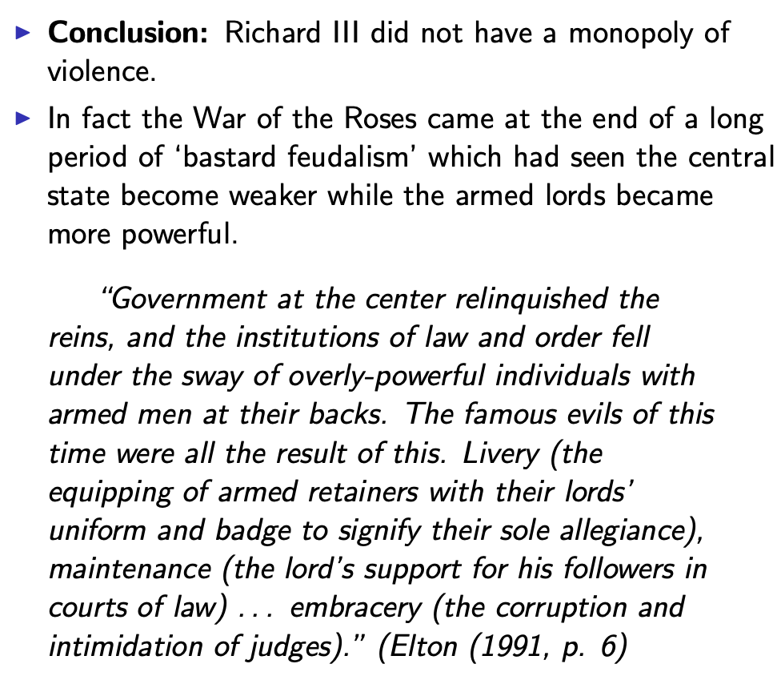
Establishing an Effective Monopoly of Violence: Implications of the Treason of the Stanleys
10:10-10:20
Slide taken from Melissa Dell

Slide 62
Marcher Lords: Warwick the Kingmaker
Adam Smith: “The great Earl of Warwick is said to have entertained every day, at his different manors, 30,000 people; and though the number here may have been exaggerated, it must, however, have been very great to admit of such exaggeration. A hospitality nearly of the same kind was exercised not many years ago in many different parts of the Highlands of Scotland…
10:10-10:20

Slide 63
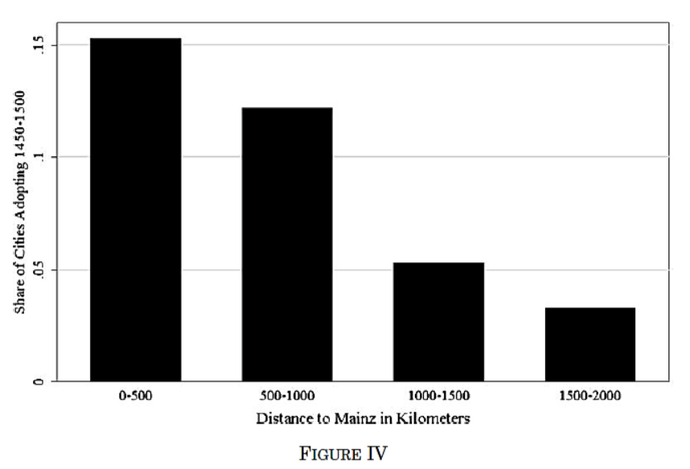
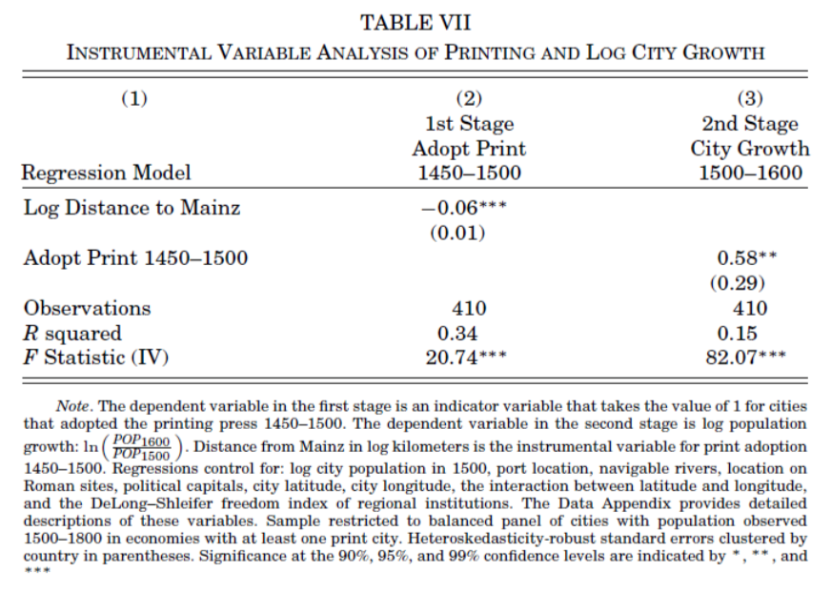
Jeremiah Dittmar (2011): The Printing Press as an Agent of Change… II
Dittmar’s Test: Compare (especially over the period 1500– 1600) population growth of cities that did and did not adopt the printing press before 1500.
Why are DIttmar’s IV estimates so big? 0.6 per century—a near doubling—as opposed to 0.2?
10:10-10:20

Slide 64
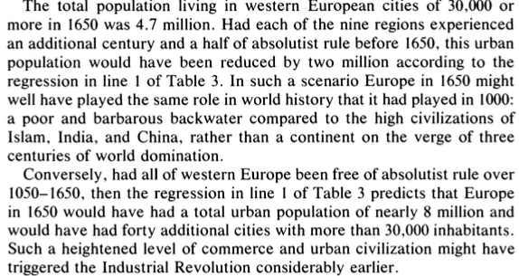
DeLong and Shleifer I
It’s a big deal…
10:10-10:20

Slide 65
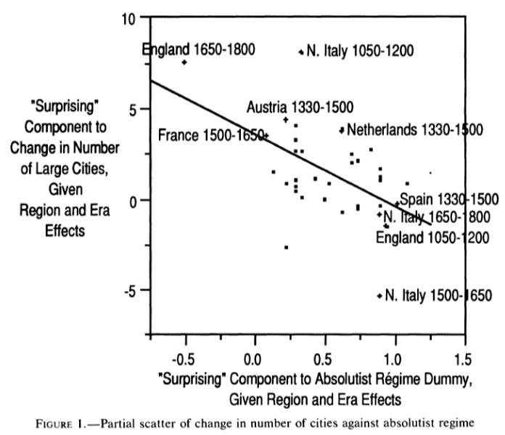
DeLong and Shleifer III
Northern Italy in 1500-1650 is “surprising” as absolutist then
England 1650-1800 is “surprising” as non-absolutist then
WTF?! with the Italian urban boom 1050-1200
Econometric problems
Normal distribution—we have only 45 observations, and 30 degrees of freedom…
The file-drawer problem…
10:10-10:20

Slide 66
Discussion
“Commercial Society” of the Eighteenth Century
An extra 1500 years of invention and innovation, yes…
Scope of control…
Columbian Exchange…
But, otherwise, how different from Antonine Rome or Sung China or Abbasid Mesopotamia?
It did occur in Antonine Rome…
Temin: no industrial revolution…
10:35-10:50

Slide 67
Review: Adam Smith
We Have a Very Keen-Eyed Contemporary Observer:
Read: Christopher Berry (2018): Adam Smith: A Very Short Introduction, chs. 1, 4-6 <https://delong.typepad.com/files/berry-smith.pdf>
The market economy as a game changer
Commercial society:
Hunter, shepherd, agricultural, and commercial stages…
“It is Smith’s explicit reference to a ‘commercial society’ that is distinctive and Smith here is a pioneer…”
Agrarian-Age power lies with the owners of land, and government is ‘a combination of the rich to oppress the poor’
Commercial society sees the growth of the rule of law—and a government that can enforce its property-rights order against local notables, roving bandits, and its own functionaries…
10:15-10:35

Slide 68
Why the Emergence of “Commercial Society”
Friedrich Engels:
“Exceptional periods, however, occur when the warring classes are so nearly equal in forces that the state power, as apparent mediator, acquires for the moment a certain independence in relation to both. This applies to the absolute monarchy of the seventeenth and eighteenth centuries, which balances the nobility and the bourgeoisie against one another; and to the Bonapartism of the First and particularly of the Second French Empire, which played off the proletariat against the bourgeoisie and the bourgeoisie against the proletariat. The latest achievement in this line, in which ruler and ruled look equally comic, is the new German Empire of the Bismarckian nation; here the capitalists and the workers are balanced against one another and both of them fleeced for the benefit of the decayed Prussian cabbage lords…” Origin of the Family…
It was in the kings’ and their bureaucracies’ interests—and they were (sometimes) able to make it stick.
10:15-10:35

Slide 69
Why the Emergence of “Commercial Society” II
Adam Smith, according to Berry:
“The feudal lords were masters… settled disputes, enforced discipline, and commanded their tenants to fight on their behalf….. [But] when foreign commerce introduced… what Smith deliberately calls frivolous and useless goods (he mentions diamond buckles) the lords sold off their land or granted long leases… undermine[d] their power to command and their ability to act as judges because those who had been previously dependent became independent: ‘For the gratification of the most childish, the meanest and the most sordid of all vanities’… these landlords gradually bartered away their whole power and authority (WN 419)…
“Smith calls this change a ‘revolution of the greatest importance to the publick happiness’ (WN 422)
But it was not brought about with the deliberate aim to further the public good…
It was, rather, an example of unintended consequences.
This made possible the ‘regular administration of justice’.
The establishment of that uniformity is crucial
Without it a commercial society is not possible
10:15-10:35

Slide 70
Once You Have the Preconditions for “Commercial Society”…
Commercial Revolution Prosperity:
“Universal opulence which extends itself to the lowest ranks of the people…”
Because of the division of labor…
Possible only in a well-governed society…
Berry: “Through the division of labour ten individuals could make 48,000 pins a day—equivalent to 4,800 each. But if each individual performed all the tasks required (drawing, straightening, cutting, pointing the wire, and so on) then less than twenty would have been manufactured. He gives three reasons for this: increased dexterity that comes from reducing each individual’s task to ‘one simple operation’; time-saving that stems from not having to transfer from one task to the next; and inventing better ways of executing the task prompted by the concentration on one task…”
Division of labor depends on the extent of the market…
And self-interest: “it is not from the benevolence of the butcher, the brewer or the baker that we expect our dinner, but from their regard to their own interest. We address ourselves not to their humanity but to their self- love and never talk to them of our own necessities but of their advantages. Nobody but a beggar chuses to depend chiefly upon the benevolence of his fellow-citizens…”
10:15-10:35

Slide 71

Smith’s “System of Natural Liberty”
Depends on Universal Principles: Smith according to Berry:
A ‘science of human nature’.
The self-interested hope of everyone to better their own condition.
The moral principle that everyone is free.
Individuals are the best judges of their own interests
The outcomes of particular exchanges redound unintentionally to the general benefit.
The ‘miserable poverty’ of the savage nations, as depicted in his Introduction, is left behind
The twin blessings of opulence and freedom are experienced.
10:15-10:35

Slide 72

Review: Why Was Pre-Industrial Progress so Slow on Average?
Our readings:
Willem M. Jongman (2007): Gibbon was Right: The Decline and Fall of the Roman Economy <https://delong.typepad.com/jongman-gibbon-was-right.pdf>
Peter Temin: The Roman Market Economy, Roman Growth <https://delong.typepad.com/files/temin-roman-growth.pdf>
Moses Finley: Technical Innovation and Economic Progress in the Ancient World <https://delong.typepad.com/finley-technical.pdf>
Josh Ober (2019): Agamemnon's Cluelessness, selections <https://delong.typepad.com/files/ober-agamemnon-selections.pdf>

Slide 73
Potential Points of View
What are the possibilities here?:
No puzzle—given how few heads they had, and given the absence of printing and the difficulty of controlled experiments, it is a miracle that they managed to advance technology as far as they did as fast as they did… (Kremer)
No: there was something wrong. They had the wrong kind of society… (Finley, critiqued by Ober)
No: something went wrong: civilization seems to be progressing up to the year 1… 0.013%/yr… 0.030%/yr… 0.061%/yr… & then it stalls out: instead of doubling to a Commercial Revolution rate of growth after the year 1, the rate of ideas growth halves again… (Jongman)

Slide 74
Our Four Readings
What possibilities do they argue for?:
Jongman:
“Population went down… production per man hour must have gone up…. The Roman Empire should have turned into a world of happy and prosperous peasants…. Reality was, of course, different… the emergence of a new social, political, and legal regime, where oppression replaces the entitlements of citizenship…”
Temin:
“The high ratio of wages to energy costs was not only absent in eighteenth-century continental Europe; it was absent as well in the Roman Empire…. There was no possibility of escaping from the Malthusian constraints… no possibility that industrialization could have begun in the ancient world…”
Finley:
“The pejorative judgments of ancient writers about labour, and specifically about the labour of the artisan, and of anyone who works for another, are too continuous, numerous, and unanimous, too wrapped up in discussions of every aspect of ancient life, to be dismissed as empty rhetoric. In other slave-owning societies for whom there is fuller documentation, these implications and their practical effects are unmistakable. Writing about the Great Trek, for example, Sir Keith Hancock said: 'The Boers very soon convinced themselves that artisans' work and slaves' work were the same thing—a conviction which struck such deep roots in their minds that their descendants in the nineteenth century left to British immigrants almost all the opportunities of skilled industrial employment in the expanding towns'. Or Tocqueville, whose I83I notebooks are filled with the theme that 'slavery is even more prejudicial to the masters than to the slaves', because, as a leading Louisville merchant said to him, 'it deprives us of the energy and spirit of enterprise that characterizes the States that have no slaves’…. Comparisons must be made with caution and reserve. But this particular one seems to me to be valid and necessary…”
Ober:
“Greeks were quite capable of the kind of reasoning necessary to build and sustain a growing economy…. Ancient Greeks, as individuals and collectives, frequently employed… rationally instrumental reasoning in economic contexts. It is nonetheless undeniable that there is a body of classical literature that exemplifies the scorn for money-making that was emphasized by the Finley school. Those expressions of scorn underpin the theory of an essentially timeless and changeless ancient economy predicated on violent extraction and gift exchange…. The approach of the Socratic philosophers to economic rationality was fundamentally critical and normative…. For Finley and his school… any activity that was not grounded in status, and in [its] power relations… was… unmoored and ephemeral…. Economic activity aimed at increasing productivity, innovations aimed at increasing efficiency, and increased consumption—rather than securing the status of the relevant actors—were, thereby, rendered more or less invisible—and in any event, unworthy of detailed study. The result was, so I suppose, both a misunderstanding of the relevant texts and a misrepresentation of the underlying social reality…”

Slide 75
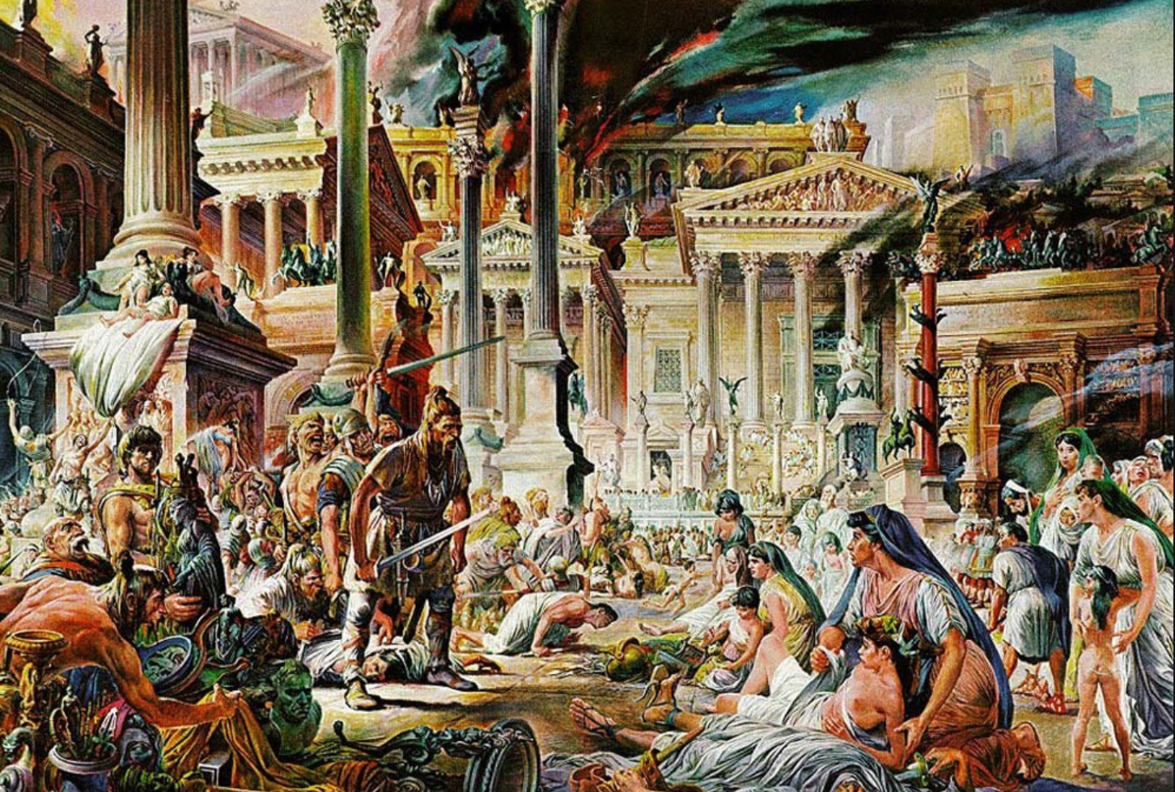


Review: The Fall of Rome
Economic Zenith, Then Economic Decline, Then Political Decline:
While the existing data are somewhat contradictory, the consensus amongst archaeologists is the early 2nd century.
A new social distinction between honestiores (high status) and humiliores (low status with different laws) was introduced.
Citizens began to lose their rights and by the end of the 2nd century, they were being tied to the land as serfs
The Barbarians were at the gates, but it seems reasonable to see this as an outcome of the weakening of Roman institutions
Earlier Rome had defeated far more formidable and better organized enemies like the Carthaginians.
Acemoglu and Robinson argue that the big fact about what preceded the decline is that political institutions moved in a much more extractive direction and this was followed by economic institutions.
Jongman (“Gibbon was Right”) proposes that the Antonine plague which hit the Roman Empire around 160AD is the most likely explanation for the collapse of Rome.
But Malthusian crises are supposed to increase living standards, not reduce them: so what is going on?
Slide taken from Melissa Dell

Slide 76
Three Great Plagues
But the demands of the empire for revenue and of the upper class for resources remain the same:
Antonine Plague (smallpox?): Antonine ⇒ Severian dynasty
Plague of St. Cyrian (Ebola-like?): Things fall completely apart, then Diocletian: between Philip the Arab and Diocletian, 18 emperors in 35 years, plus two breakaways; 12 of the 18 were assassinated
Plague of Justinian (Bubonic): Flavius Apion…

Slide 77
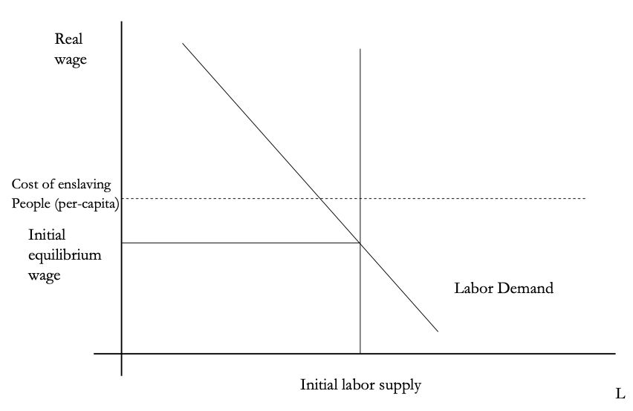
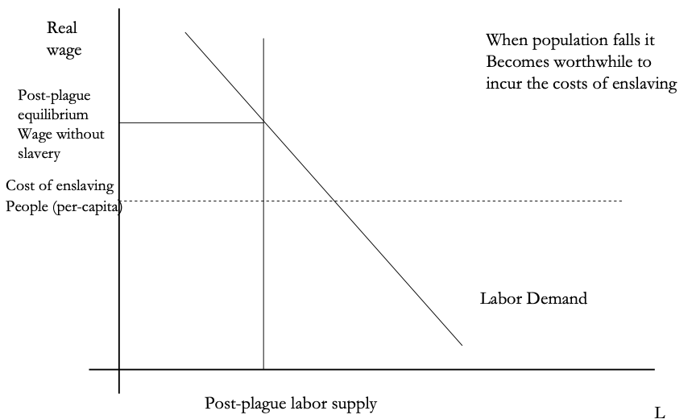
The Domar Hypothesis
You can have a leisured upper class, or abundant land relative to labor, or free labor, but not all three at once:
Slide taken from Melissa Dell

Slide 78
The Later Roman Empire
How does it compare to the expanding Roman Republic?
Militarism: in striking contrast to earlier days, a successful general is a threat to the emperor. Eighteen emperors in 35 years between Philip the Arab and Diocletian
Mobilization: In order to extract resources from a smaller population, the people must be disarmed rather than mobilized.
Distribution: The smaller pool of benefits needs to be hoarded for those with connections, not shared.
Incorporation: You can join the Goths: you cannot join the Roman upper class unless you know someone…

Slide 79
Dell’s Summary of Acemoglu and Robinson on the Rise and Fall of Rome II
For the Roman Empire, the collapse of Roman authority was pronounced, particularly in the West:
By 450AD all the trappings of Roman economic prosperity were gone.
Money vanished from circulation.
Urban areas were abandoned and buildings stripped of stone.
The roads were overgrown with weeds.
The only type of pottery which was fabricated was crude and hand made, not manufactured.
People forgot how to use mortar and they also forgot how to read and write.
Roofs were made of branches, not tiles.
The Eastern Roman Empire lived on, but it contracted significantly with the rise of Islam in the 7th Century.
Slide taken from Melissa Dell

Slide 80
Review: Republic to Empire
Political transition:
The expansion of Rome’s conquests created inequality and increasing political instability.
There were calls for the redistribution of land and power.
For example, Plebeian Tribune Tiberius Gracchus started to develop very ‘populist’ political platforms which threatened the senatorial elites.
The culmination of this was civil war, the dictatorship of Julius Caesar, and finally the creation of the Empire under Augustus.
First the principate
Then the dominate
Augustus reformed the army, removing it as a bastion of plebeian power.
His successor Tiberius stripped the assemblies of powers and gave them to the senate—and then neutered the senate
A semi-hereditary monarchy replaced the Republic:
“May good success attend the Roman senate and people and myself. I hereby adopt as my son Marcus Ulpius Nerva Traianus…”
This was a move towards more “extractive” political institutions and though it stabilized things for awhile, there was an eventual movement towards even more extractive economic institutions
Slide taken from Melissa Dell

Slide 81
Always Scribble, Scribble, Scribble! Eh! Mr. Gibbon?
Beste, Memorials:
The Duke of Gloucester, brother of King George III, permitted Mr. Gibbon to present to him the first volume of The History of the Decline and Fall of the Roman Empire. When the second volume of that work appeared, it was quite in order that it should be presented to His Royal Highness in like manner. The prince received the author with much good nature and affability, saying to him, as he laid the quarto on the table,
“Another damned thick, square book! Always, scribble, scribble, scribble! Eh! Mr. Gibbon?”

Slide 82
Always Scribble, Scribble, Scribble! Eh! Mr. Gibbon?
Five Good Emperors: Nerva-Trajan-Hadrian-Antonius Pius-Marcus Aurelius:
If a man were called to fix the period in the history of the world, during which the condition of the human race was most happy and prosperous, he would, without hesitation, name that which elapsed from the death of Domitian to the accession of Commodus.
The vast extent of the Roman empire was governed by absolute power, under the guidance of virtue and wisdom.
The armies were restrained by the firm but gentle hand of four successive emperors, whose characters and authority commanded involuntary respect.
The forms of the civil administration were carefully preserved by Nerva, Trajan, Hadrian, and the Antonines, who delighted in the image of liberty, and were pleased with considering themselves as the accountable ministers of the laws.
Such princes deserved the honor of restoring the republic, had the Romans of their days been capable of enjoying a rational freedom.
The labors of these monarchs were overpaid by
the immense reward that inseparably waited on their success;
by the honest pride of virtue, and
by the exquisite delight of beholding the general happiness of which they were the authors.

Slide 83
Aelius Aristides
The Roman Oration:
Whatever the seasons make grow and whatever countries and rivers and lakes and arts of Hellenes and non-Hellenes produce are brought from every land and sea, so that if one would look at all these things, he must needs behold them either by visiting the entire civilized world or by coming to this city. For whatever is grown and made among each people cannot fail to be here at all times and in abundance. And here the the merchant vessels come carrying these many products from all region in every season and even at every equinox, so that the city appears a kind of common emporium of the world.
Cargoes from India and, if you will, even from Arabia the Blest one can see in such numbers as to surmise that in those lands the trees will have been stripped bare and that the inhabitants of these lands, if they need anything, must come here and beg for a share of their own. Again one can see Babylonian garments and ornaments from the barbarian country beyond arriving in greater quantity and with more ease than if shippers from Naxos or from Cythnos, bearing something from those islands, had but to enter the port of Athens. Your farms are Egypt, Sicily and the civilized part of Africa.
Arrivals and departures by sea never cease, so that the wonder is not that the harbor has insufficient space for merchant vessels, but that even the sea has enough, if it really does.
And just as Hesiod said about the ends of the Ocean, that there is a common channel where all waters have one source and destination, so there is a common channel to Rome and all meet here, trade, shipping, agriculture, metallurgy, all the arts and crafts that are or ever have been, all the things that are engendered or or grow from the earth. And whatever one does not see here neither did nor does exist. And so it is not easy to which is greater, the superiority of this city in respect to the cities that now are or the superiority of this city respect to the empires that ever were…

Slide 84
Review: The Rise of Rome
Roman Institutions are key to the rise of Rome:
In 510BC, the citizens of Rome overthrew their king, Lucius Tarquinius Superbus, and created a republic.
The state was run by elected officials:
Two consuls who had the job for one year
Other magistrates: praetors, aediles, proconsuls
Tribunes.
Offices were elected, annual, and held by multiple people at the same time
This greatly reduced the ability of any one person to consolidate or exploit his power.
The institutions of the Republic contained a system of checks and balances which distributed power fairly widely.
Even if elite patrician families had far more power, it was possible for non-elites, so called plebeians, to get to the top, and they constrained the power of the elites.
Then some plebeian families become equally elite…
The nobiles
Roman assemblies:
Centuriate: 193 centuries on the basis of military organization, weighted toward the rich. Elects the magistrates, declares war and peace
Tribal: After 241 BC, 35 tribes on the basis of geographical location
Plebeian: Non-patricians, run by Tribunes
Senate
Roman institutions:
Legions
Phalanx
Manipular
Marian
Imperium
Provinciae
Proconsuls and propraetors
Slide taken from Melissa Dell

Slide 85
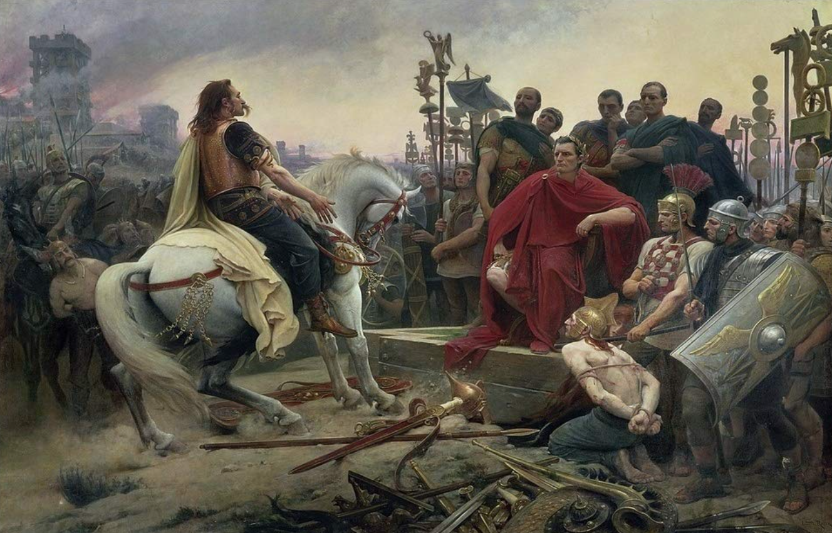
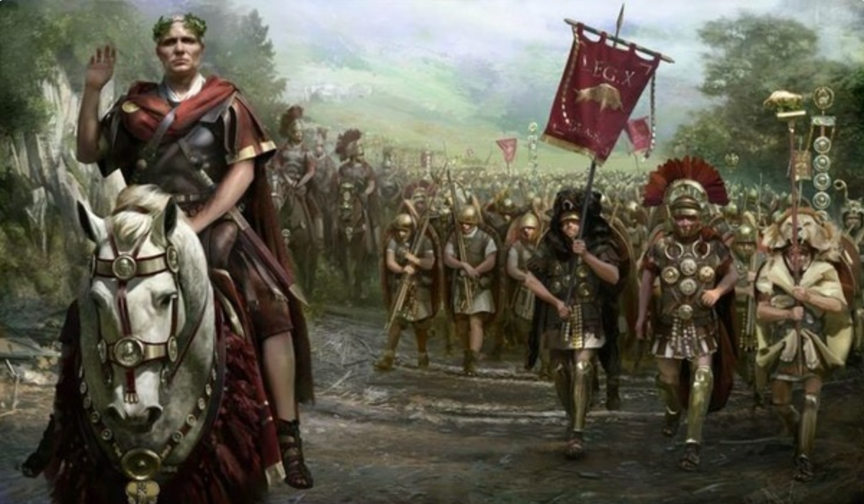
The Rise of Rome II
Roman Institutions are key to the rise of Rome:
Four key factors:
Militarism (on the part of elites competing for authority)
Mobilization (of the citizen mass)
Widely shared benefits (of conquest)
Incorporation (of conquered communities)
Mammoth military and political expansion after -340, and substantial economic, expansion
Slide taken from Melissa Dell

Slide 86
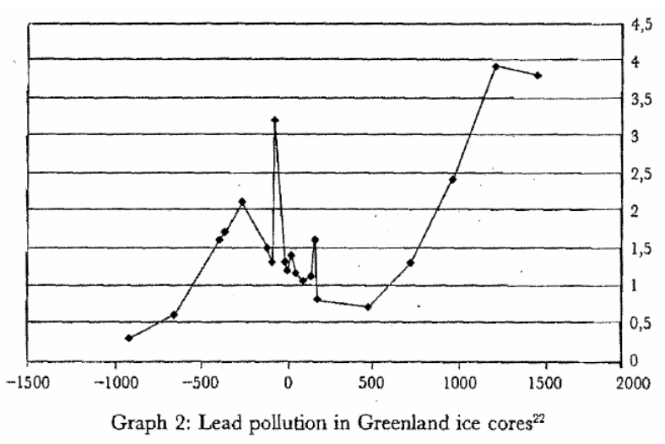
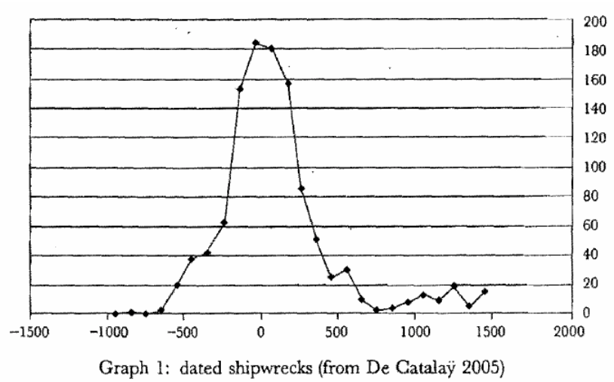
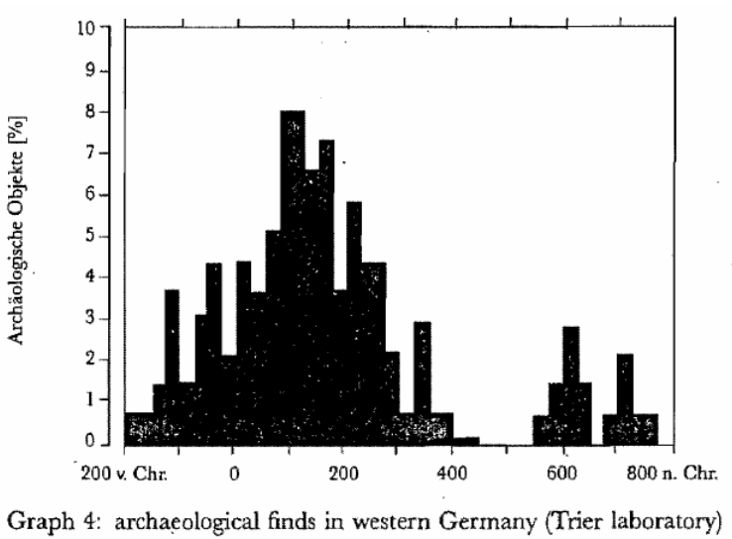
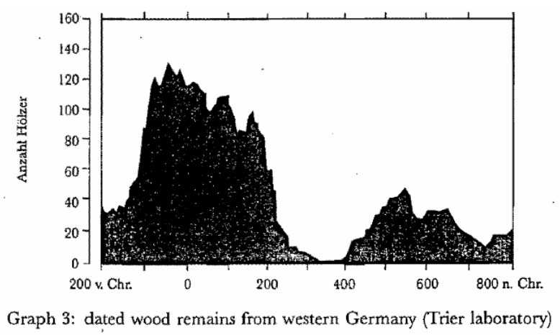

Measuring Roman Efflorescence
There are many interesting ways to track economic expansion:
Shipwrecks indicate trade, but they also track the movement of goods by fiat. For example, the citizens of Rome were kept happy by the free distribution of bread after 58BC. This was later extended to olive oil and even wine. This had to be shipped (mostly from Egypt and North Africa).
The Romans also moved around taxes levied in the provinces and supplied their troops. Some argue that 2/3 of all the ‘trade’ was actually the state moving stuff around.
For Roman citizens, economic institutions were quite good. However, the Italian economy was based on slavery (about 35% of the population of Italy were slaves at the time of the Emperor Augustus). There was little technological change.
Slide taken from Melissa Dell

Slide 87
Review: Pre-Industrial “Efflorescences”
Ideas courtesy of Jack Goldsmith, Daron Acemoglu and James Robinson:
The Malthusian model misses a great deal of the interesting action prior to the Industrial Revolution.
An alternative explanation for why there was no long-run trend in living standards is the theory of ‘efflorescence and decline’
I organize my thoughts about this with the two Malthusian equations, and with their bunch of variables and parameters: h, γ, β, φ, y^{sub}, s, δ, θ, and H that together determine y^{*mal} and L^{*mal}
This is best thought of as a filing system for factors that may be important—given the importance of both capital and labor efficiency, the roles of ideas and of resources in producing labor efficiency, and Malthusian population dynamics, these are the things you should look at

Slide 88
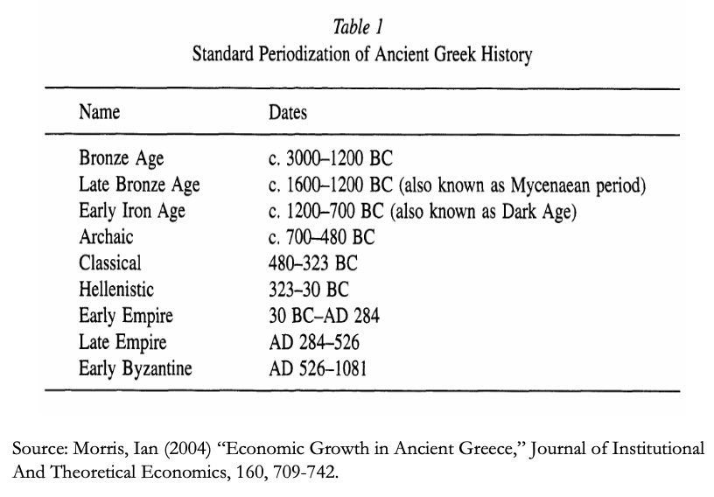
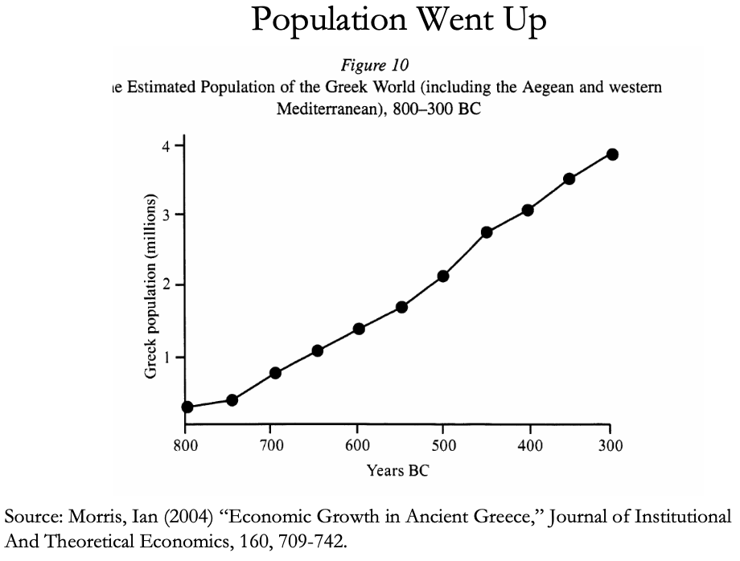
The Classical Greek Efflorescence
Emerging out of the Iron Dark Age of -1200 to -800:
When the Greek city states emerged they did so with functional systems of governance which provided public goods, such as security for trade and investment.
This initiated a period of sustained increases in living standards.
While Ancient Greece did have a period of democracy, it was relative short (less than 200 years) compared to the duration of the polity and most citizens - slaves, poor citizens who couldn’t afford their tax bill, women - could not participate.
Greek institutions (rules according to which the society was organized) tended to be “extractive.” For example, the economy was largely based upon slavery.
Slide taken from Melissa Dell

Slide 89
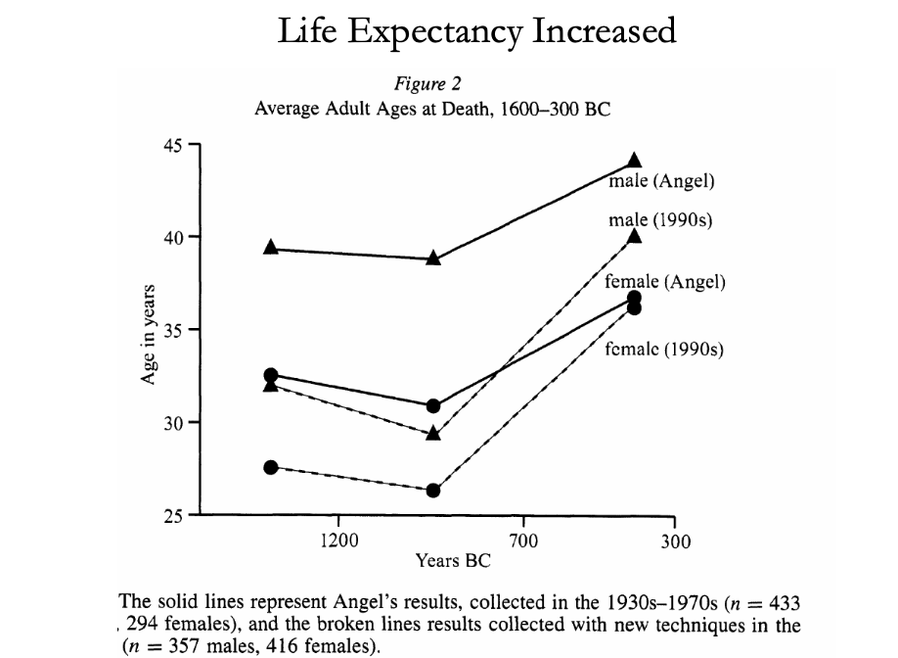
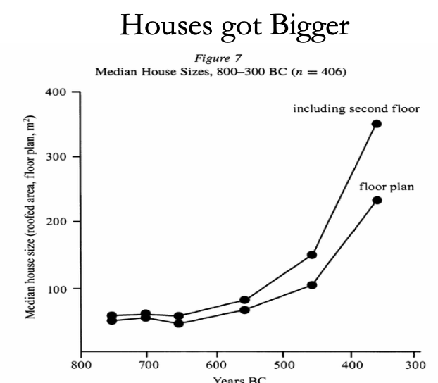
The Classical Greek Efflorescence II
“Developmental” or “Extractive”?
Extractive political institutions concentrate political power in the hands of some group who can use that power to redistribute wealth and income to themselves. This resulting concentration of wealth tends to reinforce the initial set of political institutions.
Roving bandits or stationary bandits?
Acemoglu and Robinson hypothesize that growth was not sustained in ancient societies because their institutions were extractive, and extractive institutions are incompatible with sustaining growth in the long run.
They argue that this is because extracting resources creates conflicts over who will control those resources, and it may also induce rebellion from below.
In either case political instability can bring the government and economy down.
Slide taken from Melissa Dell

Slide 90
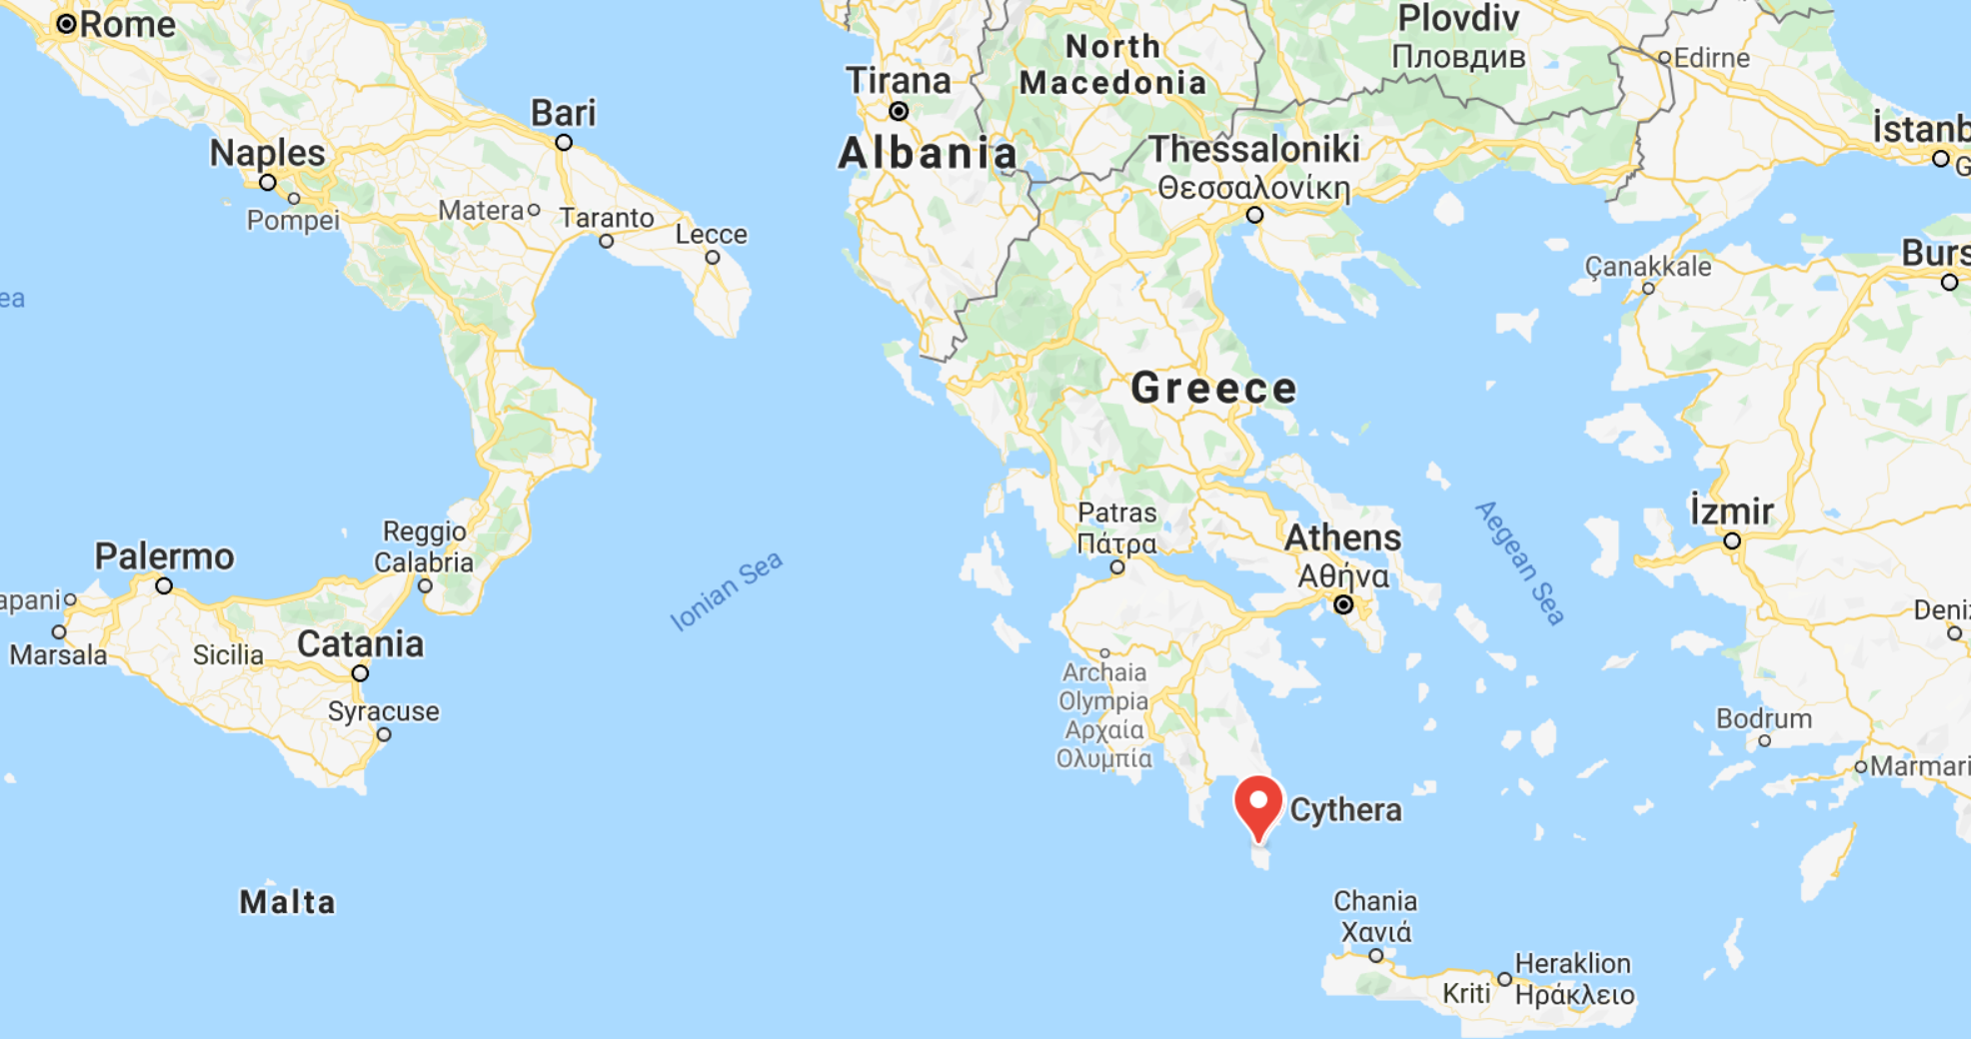
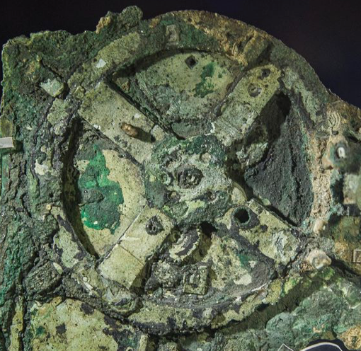
The Anti-Kythera Mechanism
What is this?
Built between -150 and -70. Rhodes13” x 7” x 4“ wooden box
Gears—largest 5” in diameter
Inscriptions
Wikipedia: “37 gear wheels enabling it to follow the movements of the Moon and the Sun through the zodiac, to predict eclipses and even to model the irregular orbit of the Moon, where the Moon's velocity is higher in its perigee than in its apogee. This motion was studied in the 2nd century BC by astronomer Hipparchus of Rhodes, and it is speculated that he may have been consulted in the machine's construction. The knowledge of this technology was lost at some point in antiquity. Similar technological works later appeared in the medieval Byzantine and Islamic worlds, but works with similar complexity did not appear again until the development of mechanical astronomical clocks in Europe in the fourteenth century…”

Slide 91
The Anti-Kythera Mechanism II
What is this?
Brian Resnick: “A main gear would move to represent the calendar year, and would, in turn, move many separate smaller gears to represent the motions of the planets, sun, and moon. So you could set the main gear to the calendar date and get approximations for where those celestial objects would be in the sky on that date…. You, as a user, could input a few simple variables and it would yield a flurry of complicated mathematical calculations.… All the user had to do was enter the main date on one gear, and through a series of subsequent gear turns, the mechanism could calculate things like the angle of the sun crossing the sky. (For some reference, mechanical calculators—which used gear ratios to add and subtract—didn’t arrive in Europe until the 1600s)…”

Slide 92
Cicero (-54): De Re Publica
“With the exception of the dream of Scipio, in the last book, the whole treatise was lost till the year 1822, when the librarian of the Vatican discovered a portion of them among the palimpsests in that library. What he discovered is translated here; but it is in a most imperfect and mutilated state. The form selected was that of a dialogue, in imitation of those of Plato…”
I.XIV:
Then Philus said: “I am not about to bring you anything new, or anything which has been thought over or discovered by me myself. But I recollect that Caius Sulpicius Gallus, who was a man of profound learning, as you are aware, when this same thing was reported to have taken place in his time, while he was staying in the house of Marcus Marcellus, who had been his colleague in the consulship, asked to see a celestial globe which Marcellus’s grandfather had saved after the capture of Syracuse from that magnificent and opulent city, without bringing to his own home any other memorial out of so great a booty; which I had often heard mentioned on account of the great fame of Archimedes; but its appearance, however, did not seem to me particularly striking. For that other is more elegant in form, and more generally known, which was made by the same Archimedes, and deposited by the same Marcellus in the Temple of Virtue at Rome.
“But as soon as Gallus had begun to explain, in a most scientific manner, the principle of this machine, I felt that the Sicilian geometrician must have possessed a genius superior to anything we usually conceive to belong to our nature. For Gallus assured us that that other solid and compact globe was a very ancient invention, and that the first model had been originally made by Thales of Miletus. That afterward Eudoxus of Cnidus, a disciple of Plato, had traced on its surface the stars that appear in the sky, and that many years subsequently, borrowing from Eudoxus this beautiful design and representation, Aratus had illustrated it in his verses, not by any science of astronomy, but by the ornament of poetic description. He added that the figure of the globe, which displayed the motions of the sun and moon, and the five planets, or wandering stars, could not be represented by the primitive solid globe; and that in this the invention of Archimedes was admirable, because he had calculated how a single revolution should maintain unequal and diversified progressions in dissimilar motions.
“In fact, when Gallus moved this globe, we observed that the moon succeeded the sun by as many turns of the wheel in the machine as days in the heavens. From whence it resulted that the progress of the sun was marked as in the heavens, and that the moon touched the point where she is obscured by the earth’s shadow at the instant the sun appears opposite….
Scipio: “I had myself a great affection for this Gallus, and I know that he was very much beloved and esteemed by my father Paulus. I recollect that when I was very young, when my father, as consul, commanded in Macedonia, and we were in the camp, our army was seized with a pious terror, because suddenly, in a clear night, the bright and full moon became eclipsed. And Gallus, who was then our lieutenant, the year before that in which he was elected consul, hesitated not, next morning, to state in the camp that it was no prodigy, and that the phenomenon which had then appeared would always appear at certain periods, when the sun was so placed that he could not affect the moon with his light…”

Slide 93
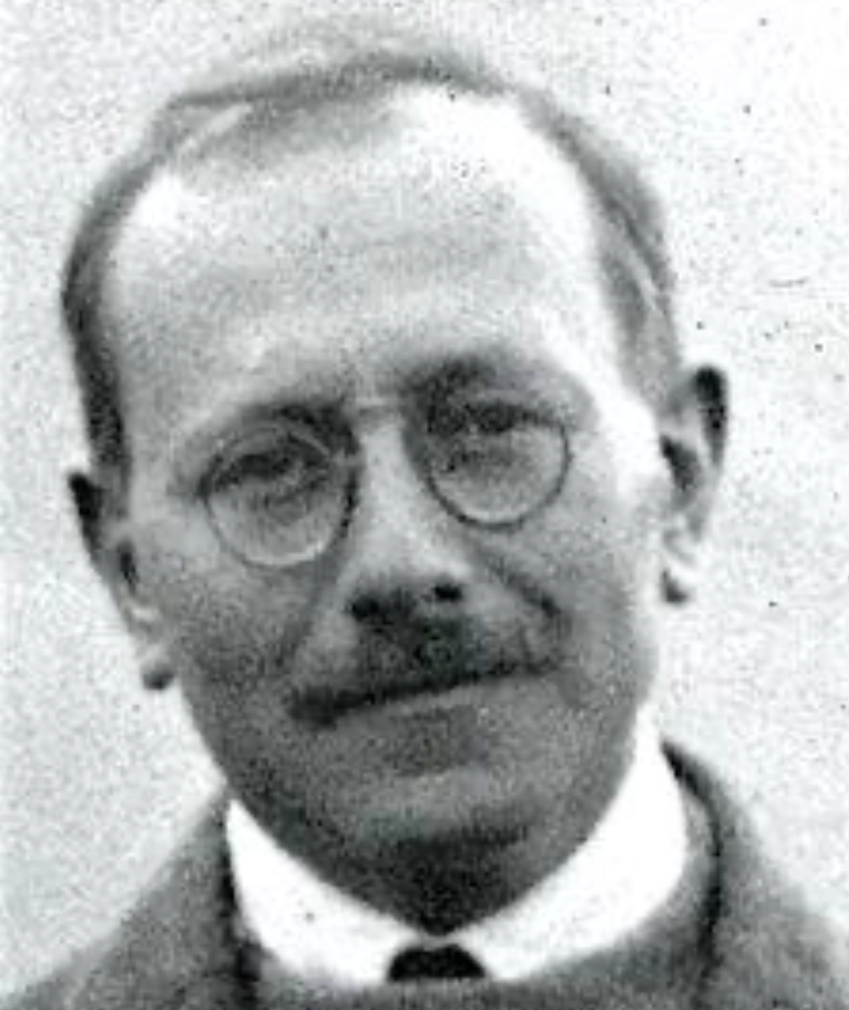
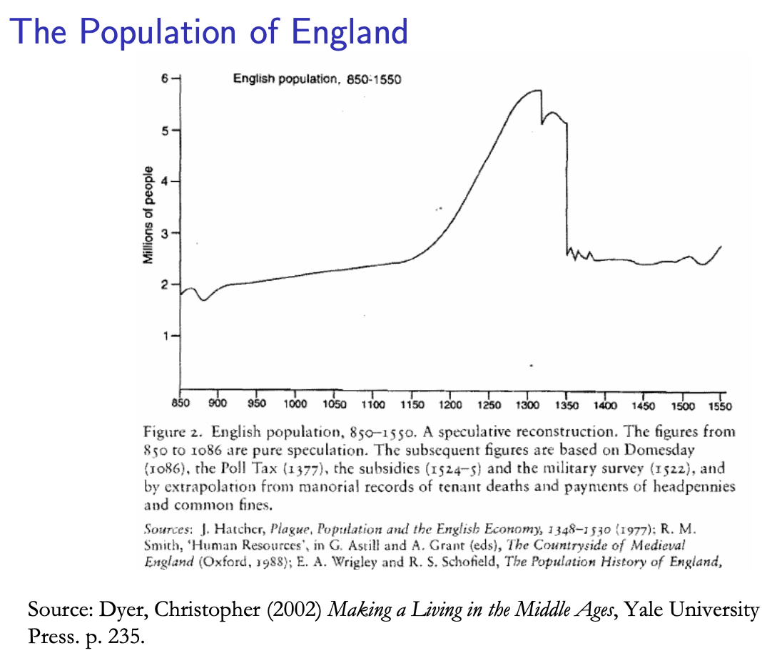
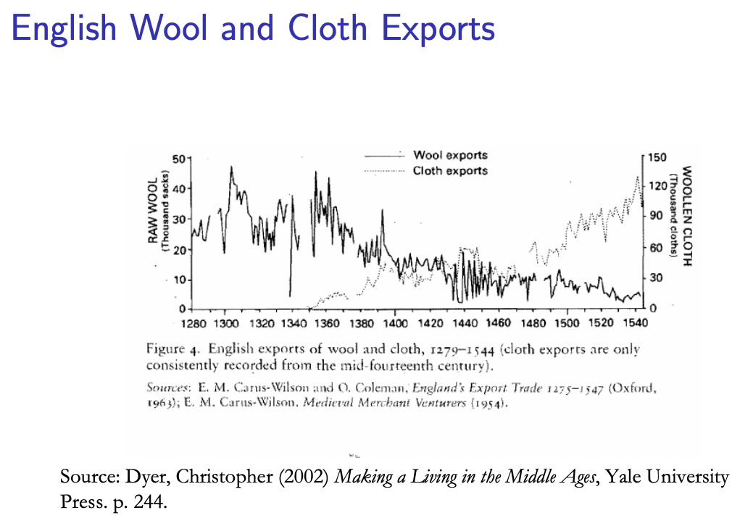
Review: Class and Conflict: at the End of the Middle Ages, Elsewhere, and Elsewhere
What was “feudalism” and how did it end?
Marc Bloch’s definitions:
A subject peasantry
Widespread use of the service tenement (i.e., the fief) instead of a salary (or of private property plus taxation and then purchase)
The supremacy of a caste of specialized warriors
Ties of obedience and protection which bind man to man
Within the warrior class, these ties assume the distinctive form called vassalage
Fragmentation of authority
Disorder and private war
But also, other forms of association, family, and state surviving…
By the late Middle Ages feudalism was a stable system
Trade and population expanded
What data we have shows the number and size of cities increasing
Slide taken from Melissa Dell

Slide 94
A Four-Cornered Fight
Kings, Lords, Commons, & Peasants:
Class alliances, class power, and class conflict…
Plus ideological legitimations…
Friedrich Engels: “Exceptional periods, however, occur when the warring classes are so nearly equal in forces that the state power, as apparent mediator, acquires for the moment a certain independence in relation to both. This applies to the absolute monarchy of the seventeenth and eighteenth centuries, which balances the nobility and the bourgeoisie against one another; and to the Bonapartism of the First and particularly of the Second French Empire, which played off the proletariat against the bourgeoisie and the bourgeoisie against the proletariat. The latest achievement in this line, in which ruler and ruled look equally comic, is the new German Empire of the Bismarckian nation; here the capitalists and the workers are balanced against one another and both of them fleeced for the benefit of the decayed Prussian cabbage Junker-squires…”
This is not just in exceptional periods…
The relative autonomy of the state is the rule, not the exception…

Slide 95
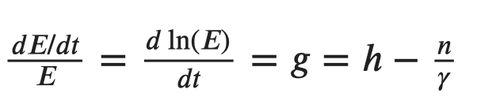
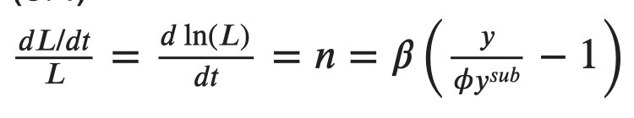

Review: Malthusian Models and Reality

Slide 96

Eastern Europe and the “Second Serfdom”
The percentage of people killed in Europe was similar across space:
After the plague, landlords in Eastern Europe started to take over large tracts of land and expand their holdings, which were already larger than those in Western Europe.
Towns were weaker and less populous and rather than becoming freer, workers began to see their already existing freedoms encroached on: the Domar hypothesis at work.
This contrasts with western Europe.
Effects became especially pronounced after 1500, when Western Europe began to demand the agricultural goods which the East produced.
Eastern landlords ratcheted up their control over the labor force to expand their production.
Mecklenberg: in 1500, peasants owed only a few days service a year; by 1600 this was three days/week; children had to work for the lord for free for several years.
In Hungary, landlords legislated one day a week of unpaid labor services for each worker. In 1550 this was raised to 2 days per week. By the end of the century it was 3 days. Serfs subject to these rules made up 90% of the rural population.
What was it that allowed the Spanish settlers in Mexico to keep wages so low, when in England after the Black Death the state had been incapable of enforcing the Statue of Laborers and stopping wages from rising?
William the Conqueror rewarded his army by providing them with parceled landholdings to prevent them from becoming powerful regional warlords (save for the “marcher lords” along the Scottish and Welsh borders).
Many landholders in close proximity created intense competitive pressures for labor in the wake of the Black Death.
Slide taken from Melissa Dell

Slide 97

Is Malthus Right? II
At the macro level, yes; but there are lots of interesting meso- and small-scale puzzles:
In addition, measures of good government, such as proxies for constraints on the executive, are correlated with urbanization in this period.
For example, DeLong and Shleifer (1993) showed there was a strong correlation between form of government and urbanization in the pre-modern world
Charles Wilson (1967): Trade, Society, and the State: "The two areas which in 1500 represented the richest and most advanced concentrations of trade, industry and wealth were the quadrilateral formed by the Italian cities Milan, Venice, Florence and Genoa; and the strip of the Netherlands that ran from Ypres north-east past Ghent and Bruges up to Antwerp. It was not merely coincidence that these were the areas where the tradesmen of the cities had been most successful in emancipating themselves from feudal interference and in keeping at bay the newer threat of more centralized political control offered by the new monarchies. In the fleeting intervals between the storms of politics and war, men here glimpsed the material advance that was possible when tradesmen were left in peace unflattered by the attentions of strategists who regarded their activities as the sinews of war…”
Slide taken from Melissa Dell

Slide 98
Malthus: Summing Up
On the broadest scale only:
The simple Malthusian model may indeed capture some realities.
If labor markets are competitive, population growth may indeed induce a decline in wages.
Or if there is a fixed amount of land and few opportunities for labor intensive cultivation systems, a population increase may lead to a decline in output per worker.
However, the reality is typically much more messy.
How wages respond to changes in income will depend on institutions.
Thus the overwhelming likelihood that institutional or cultural factors also shaped pre-modern growth
It was not simply being dictated by the Malthusian relationship between births, deaths, and income.
Slide taken from Melissa Dell

Slide 99

Review: “Subsistence”

Slide 100



“Bare-Bones”
From Clark & Allen:
"Manual workers”—70% of median, 50% of average income
In 1800: the English population in 1800 is a very rich pre-industrial population
70% of spending spent on food
30-40% grains
20% meat and dairy
“Bare-bones” subsistence
Cities: Malthus rules, but it takes centuries—and other things can and do happen

Slide 101




Review: Determinants of Technological and Organizational Progress
How do we make sense of the fact that technological and organizational progress was so slow back then and is so (relatively) rapid now?
Two heads are (almost) better than one
But that does not quite work
Add in additional drag from first picking low-hanging fruit
What causes the increase in Lstem?
What institutions make it profitable for nstem to be higher?
Plus:
Learning by doing
Productivity through embodiment
Technology transfer through contact

Slide 102
Review: Solow-Malthus Model Basics
How do we make sense of the fact that people were ingenious and inventive back before 1500, and yet standards of living did not increase?
Although population did increase—slowly
Other parts of the model
Balanced-growth equilibrium
Convergence to equilibrium
Lecture notes: <https://nbviewer.jupyter.org/github/braddelong/long-form-drafts/blob/master/solow-model-5-pre-industrial.ipynb>
datahub: <http://datahub.berkeley.edu/user-redirect/interact?account=braddelong&repo=long-form-drafts&branch=master&path=solow-model-5-pre-industrial.ipynb>

Slide 103
Understanding the Solow-Malthus Equilibrium: Population and Labor Force
Notes:

Slide 104
Understanding the Solow-Mathus Equilibrium: Prosperity
Notes:

Slide 105

Steady-State and Along the Transition Path
The fall of an empire:
<https://nbviewer.jupyter.org/github/braddelong/LS2019/blob/master/2019-10-14-Ancient_Economies.ipynb>
A decline in inequality, taste for luxuries, and taste for urban living: Δφ = -0.25
A decline in law-and-order that produces a sharp fall in the savings rate: Δs = -0.10

Slide 106






Review: Solow Model Basics
Lecture Notes: <https://www.bradford-delong.com/2020/01/lecture-notes-the-solow-growth-model-the-history-of-economic-growth-econ-135.html>

Slide 107

Solving the Model

Slide 108

Along the Balanced-Growth Path
Everything except κ—which is constant—grows at a constant proportional rate: either n, or g, or n+g;
Labor force L grows at n
Income per worker y and the efficiency of labor E grow at g
Total income Y and the capital stock K grow at n+g

Slide 109
Review: Long-Run Patterns: Global h, g, & n

Slide 110

Long-Run Patterns: “Western” h, g & n
Where does the “ρ” come from?
“Ghost acreage”—conquest and resource utilization (sugar islands, timberlands, cottonlands, etc.)
Cultural expansion—Australia, Canada, New Zealand, & U.S.; Spain & Italy & Scandinavia; plus Japan, Korea, Taiwan, Hong Kong, & Singapore

Slide 111

One Figure: A Great Divergence
10:20
From 1800 to 2018:
The dots start with a 3-1 spread in incomes and a 10-year spread in life expectancy.
All the arrows go up.
Some arrows—mostly those already to the right—go right fast.
Other arrows go right slowly.

Slide 112

China and India and America, 1800-1975
From 1800 to 1975:
Measured living standards and productivity levels improve fourteen-fold in the United States…
…& less than 30% in China & India…
…in spite of economic, transport, and cultural globalization…
This is crazy!
A “great divergence”
Not only were China & India relatively poor in 1800, they fell further behind thereafter

Slide 113

China and India and America, 1975–2018
From 1975-2018:
Measured living standards and productivity levels…
…54.9/25.9 = 2.12 in America…
…16.0/0.9 = 17.8 in China…
…6.9/1.2 = 5.8 in India…

Slide 114

Review: Allen: Reform and Democracy
Robert Allen (2017): The Industrial Revolution: A Very Short Introduction <https://delong.typepad.com/files/allen-industrial.pdf>, chs. 3, 5-6:
Enlightenment, literacy, pamphlets, The Rights of Man (sells 1 million copies), & the French Revolution
60,000-strong Manchester demonstration in 1819: eleven killed: “Peterloo”
“Reform that we may preserve”: 1832 Reform Bill
Virtual representation
Divide the reformers
1833: Factory Act—9-hour day for children under 12
1834: New Poor Law—workhouses

Slide 115

Allen: Reform and Democracy II
Robert Allen (2017): The Industrial Revolution: A Very Short Introduction <https://delong.typepad.com/files/allen-industrial.pdf>, chs. 3, 5-6:
1833: Factory Act—9-hour day for children under 12
1834: New Poor Law—workhouses
1838: People’s Charter
1846: Corn Law Repeal
The “condition of England”
John Stuart Mill (1848 and 1871): “It is questionable if all the mechanical inventions yet made have lightened the day's toil of any human being. They have enabled a greater population to live the same life of drudgery and imprisonment…”
1846-67: Real wage stagnation ends: average consumption per head in working class families rose by 42 per cent…

Slide 116
The People’s Charter
The People's Charter called for six reforms to make the political system more democratic:
A vote for every man twenty-one years of age, of sound mind, and not undergoing punishment for a crime.
The secret ballot to protect the elector in the exercise of his vote.
No property qualification for Members of Parliament in order to allow the constituencies to return the man of their choice.
Payment of Members, enabling tradesmen, working men, or other persons of modest means to leave or interrupt their livelihood to attend to the interests of the nation.
Equal constituencies, securing the same amount of representation for the same number of electors, instead of allowing less populous constituencies to have as much or more weight than larger ones.
Annual Parliamentary elections, thus presenting the most effectual check to bribery and intimidation, since no purse could buy a constituency under a system of universal manhood suffrage in each twelve-month period

Slide 117
Greg Clark Being Contrarian
There were lots of technological “revolutions” before the Industrial Revolution
But they all petered out because of low price-elasticity of demand
Coal-steam-cotton-machinery-textiles-rails were different
But even that was reaching limits to growth by 1870 or so…
The classic British Industrial Revolution more a comparative-advantage concentration of global manufacturing than true modern economic growth…

Slide 118
Karl Marx (1867): The Key is “Capitalism”—Market Economy Plus…
Karl Marx (1867), "The Secret of Primitive Capital Accumulation," Capital, Vol. 1, Part VIII, Chapters 26-32 http://tinyurl.com/dl20090112k
“We have seen how money is changed into capital; how through capital surplus-value is made, and from surplus-value more capital. But the accumulation of capital presupposes surplus-value; surplus-value presupposes capitalistic production; capitalistic production presupposes the pre-existence of considerable masses of capital and of labour power in the hands of producers of commodities. The whole movement, therefore, seems to turn in a vicious circle, out of which we can only get by supposing a primitive accumulation (previous accumulation of Adam Smith) preceding capitalistic accumulation; an accumulation not the result of the capitalistic mode of production, but its starting point…”
“The immediate producer, the labourer, could only dispose of his own person after he had ceased to be attached to the soil… the slave, serf, or bondsman of another. To become a free seller of labour power… he must further have escaped from the regime of the guilds…. The historical movement which changes the producers into wage-workers… their emancipation from serfdom and from the fetters of the guilds… alone exists for our bourgeois historians…”
“But… these new freedmen… [were also] robbed of all their own means of production, and of all the guarantees of existence afforded by the old feudal arrangements. And the history of this, their expropriation, is written in the annals of mankind in letters of blood and fire…”
Workers must work for wages…
Capitalists must invest and accumulate…

Slide 119

Karl Marx & Friedrich Engels
Paean to the Bourgeoisie:
“The bourgeoisie cannot exist without constantly revolutionising the instruments of production, and thereby the relations of production, and with them the whole relations of society. Conservation of the old modes of production in unaltered form, was, on the contrary, the first condition of existence for all earlier industrial classes…”
9:50-9:55

Slide 120
Paean to the Bourgeosie II
Revolutionary Change and Unveiling:
“Constant revolutionising of production,
“uninterrupted disturbance of all social conditions,
“everlasting uncertainty and agitation distinguish the bourgeois epoch from all earlier ones.
“All fixed, fast-frozen relations, with their train of ancient and venerable prejudices and opinions, are swept away,
“all new-formed ones become antiquated before they can ossify.
“All that is solid melts into air,
“all that is holy is profaned, and
“man is at last compelled to face with sober senses his real conditions of life, and his relations with his kind…
9:50-9:55

Slide 121
Paean to the Bourgeosie III
Globalization:
“The bourgeoisie has subjected the country to the rule of the towns.
“It has created enormous cities,
“has greatly increased the urban population as compared with the rural, and
“has thus rescued a considerable part of the population from the idiocy of rural life.
“Just as it has made the country dependent on the towns,
“so it has made barbarian and semi-barbarian countries dependent on the civilised ones,
“nations of peasants on nations of bourgeois,
“the East on the West…
9:50-9:55

Slide 122
Karl Marx: Capital: Part VII: The Accumulation of Capital
This is where the book starts to sing—to me. What I got out of chapter 23:
To quote from the Communist Manifesto, “the executive of the modern state is a committee for managing the affairs of the business class.” Wealth speaks loudly, and influences the government to arrange things for the convenience of wealth—to keep wages low, and workers available. Marx quotes a protest from The Times of London against the demands of capital in 1863:
“Mr. Edmund Potter is so impressed with the exceptional and supreme importance of the cotton masters that, in order to preserve this class and perpetuate their profession, he would keep half a million of the labouring class confined in a great moral workhouse against their will.… We must confess that we do not think it ‘worth while,’ or even possible, to keep the human machinery in order—that is to shut it up and keep it oiled till it is wanted. Human machinery will rust under inaction, oil and rub it as you may. Moreover, the human machinery will, as we have just seen, get the steam up of its own accord, and burst or run amuck…”

Slide 123
“Alienation”
Capital is made up of what the workers produce:
But what the workers produce then does not advance their interests or make them happy…
Instead, what the workers have produced somehow escapes from human control…
It then imposes itself on people, and bosses them around…
Note: it’s not that capital transfers human freedom and flourishing from the workers to the capitalists:
The capitalists have to act like capitalists—push wages down, speedup the line, and reinvest their profits
If they don’t? They become uncompetitive go bankrupt, and become workers
This is Marx’s theory of “alienation”—what one has made then remakes you
“Here in America, everyone watches television. In Soviet Russia, television watches you!”

Slide 124
Accumulate, Accumulate!
A capitalist market economy is driven to invest and reinvest to boost the economy’s capital stock:
“Accumulation for the sake of accumulation, production for the sake of production: this was the formula in which classical economics expressed the historical mission of the bourgeoisie in the period of its domination. Not for one instant did it deceive itself over the nature of wealth’s birth-pangs. But what use is it to lament a historical necessity? If, in the eyes of classical economics, the proletarian is merely a machine for the production of surplus-value, the capitalist too is merely a machine for the transformation of this surplus-value into surplus capital…”
A capitalist market economy is driven to become more capital intensive:
“The law of the progressive growth of the constant part of capital in comparison with the variable part is confirmed at every step … by the comparative analysis of the prices of commodities, whether we compare different economic epochs or different nations in the same epoch. The relative magnitude of the part of the price which represents the value of the means of production, or the constant part of the capital, is in direct proportion to the progress of accumulation, whereas the relative magnitude of the other part of the price, which represents the variable part of the capital, or the payment made for labour, is in inverse proportion to the progress of accumulation…”

Slide 125
Invention and Innovation Deskill Workers, and Put Downward Pressure on the Demand for Labor
Marx believes that machinery is not a complement to but a substitute for labor:
“Since the demand for labour is determined not by the extent of the total capital but by its variable constituent alone, that demand falls progressively with the growth of the total capital, instead of rising in proportion to it, as was previously assumed….
“[Capital] produces indeed in direct relation with its own energy and extent, a relatively redundant working population, i.e. a population which is superfluous to capital’s average requirements for its own valorization, and is therefore a surplus population….
“The working population therefore produces both the accumulation of capital and the means by which it is itself made relatively superfluous…”

Slide 126
The “Industrial Reserve Army” of the Non-Employed
For Marx, it is inconceivable that there might be a permanent, durable increase in the average wage level:
“The industrial reserve army, during the periods of stagnation and average prosperity, weighs down the active army of workers; during the periods of over-production and feverish activity, it puts a curb on their pretensions. The relative surplus population is therefore the background against which the law of the demand and supply of labour does its work. It confines the field of action of this law to the limits absolutely convenient to capital’s drive to exploit and dominate the workers…”
Note that the century and a half after Marx wrote saw wages multiply tenfold in the Global North world economy core.
There is something wrong with the argument…
November 12, 2019

Slide 127
Forest of Outstretched Arms…
In fact, for Marx it is inconceivable the average wage level will stay above bare subsistence:
Karl Marx:
“The most diverse machines are now applied to the manufacture of the machines themselves…. The labourers employed in machine factories can but play the role of very stupid machines alongside of the highly ingenious machines…. To sum up: the more productive capital grows, the more it extends the division of labour and the application of machinery; the more the division of labour and the application of machinery extend, the more does competition extend among the workers, the more do their wages shrink together…. A mass of small business men and of people living upon the interest of their capitals is precipitated into the ranks of the working class…. Thus the forest of outstretched arms, begging for work, grows ever thicker, while the arms themselves grow every leaner…”
Note that the century and a half after Marx wrote saw wages multiply tenfold in the Global North world economy core.
There is something wrong with the argument…

Slide 128
Karl Marx: Summing Up
Marx and His Vision:
Marx’s vision: utopia is now, thanks to the epoch of the bourgeoisie, within our grasp
But the bourgeoisie that has performed this historic task is now the major obstacle to utopia
The Marxist movement: really-existing-socialism 1917-1991 not the brightest light on humanity’s tree of good ideas…
Marx’s three-stage trajectory: philosopher/analyst/economist
Marx’s three intellectual faces: prophet, political analyst, economist:
Marx the prophet… unhelpful for this world (New Jerusalem)
Marx the organizer and analyst… largely wrong (capitalism stripping away the veil of illusion; ruling class will never moderate the system; factory and workers solidarity as the future)
Marx the economist… wrong and right

Slide 129
Karl Marx the Economist
The Good:
Three:
Fever-fits of financial crisis and business cycle
Among the first to understand how transformative the Industrial Revolution would be
Very insightful about the history of industrialization
Marx’s genius responsible for the good
The Bad:
Also three:
Capital always a substitute for labor
Markets as always a source of mystification and oppression
Market economy cannot deliver a good division of income
Hegel, Manchester, the (inherited from Ricardo) Labor Theory of Value, and stubbornness responsible for the bad

Slide 130
Sources of Marx’s Misconceptions: Hegel
Here is Engels trying to make Marx’s coquetting with Hegel’s modes of expression clear:
“Marx says: ‘It is the negation of negation. This re-establishes individual property, but on the basis of the acquisitions of the capitalist era, i.e., on co-operation of free workers and their possession in common of the land and of the means of production produced by labour…’
The state of things brought about by the expropriation of the expropriators is therefore characterised as the re-establishment of individual property, but on the basis of the social ownership of the land and of the means of production produced by labour itself.
To anyone who understands plain talk this means that social ownership extends to the land and the other means of production, and individual ownership to the products, that is, the articles of consumption.
And in order to make the matter comprehensible even to children of six, Marx assumes on page 56 ‘a community of free individuals, carrying on their work with the means of production in common, in which the labour-power of all the different individuals is consciously applied as the combined labour-power of the community’, that is, a society organised on a socialist basis; and
he continues: ‘The total product of our community is a social product. One portion serves as fresh means of production and remains social. But another portion is consumed by the members as means of subsistence. A distribution of this portion amongst them is consequently necessary’.
And surely that is clear enough even for Herr Dühring, in spite of his having Hegel on his brain…”
This does not help

Slide 131
Sources of Marx’s Misconceptions
Manchester:
Manchester, especially in the aftermath of the Irish Potato Famine, an unusual outlier—not a model for the future…
The Labor Theory of Value:
It just does not work…
Stubbornness:
What do you do when the world surprises you?
Do you double down, and turn all the ingenuity of your brain to figuring out reasons why what you had thought to be true and what is apparently false is true after all?
Or do you mark your beliefs to market?

Slide 132
A Paragraph to Note
How should we read this paragraph?:
“The law... of surplus-value produced... clearly contradicts all experience based on appearance.... A cotton spinner, who... employs... little variable capital, does not, on account of this, pocket less profit or surplus-value than a baker... [with] much variable... capital. For the solution of this apparent contradiction, many intermediate terms are as yet wanted, as from the standpoint of elementary algebra many intermediate terms are wanted to understand that 0/0 may represent an actual magnitude.... It will be seen later how the school of Ricardo has come to grief over this stumbling block. Vulgar economy which, indeed, ‘has really learnt nothing’, here as everywhere sticks to appearances in opposition to the law which regulates and explains them. In opposition to Spinoza, it believes that “ignorance is a sufficient reason”...
That equal capitals deployed over equal times with equal degrees of risk yield equal profits independent of how many workers their deployment sets to work should have made Marx rethink.
But it did not: instead it made him add epicycle upon epicycle…

Slide 133
David Landes: Why Northwest Europe? Why Not China?
China had two chances:
First, to generate a continuing, self-sustaining process of scientific and technological advance on the basis of its indigenous traditions and achievements
Second, to learn from European science and technology once the foreign “barbarians” entered the Chi- nese domain in the sixteenth century.
The first failure has elicited much scholarly inquiry and analysis. And yet it remains an abiding mystery.
Chinese priority:
Textiles: a power-driven spinning machine in the thirteenth century, some 500 years before the England of the Industrial Revolution knew water frames and mules
Iron: China early learned to use coal and probably coke (as against charcoal) in blast furnaces for smelting iron and were turning out perhaps as many as 125,000 tons of pig iron by the later eleventh
Other industries: the wheelbarrow, the stirrup, the rigid horse collar (to prevent choking), the compass, paper, printing, gunpowder, porcelain
The mystery lies in the failure of China to realize the potential of some of the most important of these inventions….
Chinese industrial history offers a number of examples of technological regression and oblivion:
The machine to spin hemp was never adapted to the manufacture of cotton
Cotton spinning was never mechanized
Coal/coke smelting was allowed to fall into disuse, along with the iron industry
9:55-10:10

Slide 134
Landes: Conventional Explanations (of European Success) Inadequate
But almost every element usually regarded by historians as a major contributory cause to the Industrial Revolution in north-western Europe was also present in China:
A revolution in the relations between social classes, at least in the countryside
Only Galilean-Newtonian science was missing; but in the short run this was not important.
Had the Chinese possessed, or developed, the seventeenth-century European mania for tinkering and improving, they could easily have made an efficient spinning machine out of the primitive model described by Wang Chen.
A steam engine would have been more difficult; but it should not have posed insuperable difficulties to a people who had been building double-acting piston flame-throwers in the Sung dynasty.
The crucial point is that nobody tried.
In most fields, agriculture being the chief exception, Chinese technology stopped progressing well before the point at which a lack of scientific knowledge had become a serious obstacle
9:55-10:10

Slide 135
Landes: Sinologist Explanations (of China’s Failure)
Partial explanations only:
First, China lacked a free market and institutionalized property rights.
The Chinese state was always stepping in to interfere with private enterprise—to take over certain activities, to prohibit and inhibit others, to manipulate prices, to exact bribes:
Motivated by a desire to reserve labor to agriculture
To control important resources (salt and iron, for example)
By an appetite for revenue (the story of the goose that laid the golden eggs is a leitmotif of Chinese history);
By fear and disapproval of self-enrichment, except by officials, giving rise in turn to abundant corruption and rent-seeking
By a distaste for maritime trade… [seen] as a diversion from imperial concerns, as a divisive force and source of income inequality in the ecumenical empire, and worse yet, as an invitation to exit.
This state intervention and interference encountered evasion and resistance; indeed, the very needs of state compelled a certain tolerance for disobedience.
Still, the goal, the aim, the ideal was the ineffable stillness of immobility.
The Hongwu (“Vast Martial”) emperor… He wanted rather to immobilize the realm. People were to stay put and move only with the permission of the state—at home and abroad. People who went outside China without per- mission were liable to execution on their return. The Ming code of core laws also sought to block social mobility, with severe penalties for those jumping professional and occupational barriers.
The reason the Chinese did not develop based on their scientific knowledge is that no one was trying. Why try?
In all this, the contrast with Europe was marked.
9:55-10:10

Slide 136
Landes: Sinologist Explanations (of China’s Failure) II
Elvin (1973, pp. 224–225) captures some of this:
It was the great size of the Chinese Empire which made the adoption of the policies of the Ming emperors possible.
In a Chinese subcontinent made up of smaller independent states, like those of the Five Dynasties [907-960 C.E.] or the Ten Kingdoms, no government could have afforded to close itself off. International economic interdependence (as that between regions would have become) would have removed this option; and the need for diplomatic and military alliances, and revenue from foreign trade, would have made isolationism undesirable.
With smaller states, there might also have been, as there was in north-western Europe in early modern times, a closer conscious identification of the governed with their countries and rulers.
Why this peculiarly European joy in discovery? This pleasure in the new and better? This cultivation of invention—or what some have called “the invention of invention”?
Different scholars have suggested a variety of reasons, typically related to religious values;
The Judaeo-Christian respect for manual labor, summed up in a number of biblical injunctions. One example will suffice: when God warns Noah of the coming flood and tells him he will be saved, it is not God who saves him. “Build thee an ark of gopher wood,” says the Lord
The Judaeo-Christian subordination of nature to man—a sharp departure from widespread animistic beliefs and practices that saw something of the divine in every tree and stream (hence the naiads and dryads).
The Judaeo-Christian sense of linear time. Other societies thought of time as cyclical, returning to earlier stages and starting over again.
In the last analysis, however, I would stress the role of the market:
Enterprise was free in Europe
Innovation worked and paid,
Rulers and vested interests were narrowly constrained in what they could do to prevent or discourage innovation
Success bred imitation and emulation
9:55-10:10

